Slide 1
Gambling Overview: Understanding the Impact
^{October 10th, 2024}
Nora C. Larson (she/her), M.Ed. CHES® OCPS ICPS
Notes:
Nabil Start and will talk briefly about fellowship and reason
Nora will then take it from there

Slide 2
Self-Care Reminder
The following presentation contains gambling and suicide. ​
​
If you or someone you know has a gambling problem or mental health crisis, help is available. ​
​
Call the Ohio Problem Gambling Helpline 24/7 at 1-800-589-9966​
​
Recovery Resources is your best practice site for gambling treatment and prevention services​
​

Slide 3
Objectives
After the presentation, participants will have a better understanding of gambling as it relates to:​
Understand the definition​ of gambling
Identify several types of available gambling ​
Learn the warning signs​ and predictors ​
Responsible and healthy approach
Understand the integration of co-occurring patterns between substance and behavioral addictions ​
Learn the about the available screening tools​
Find out the new gambling trends ​
How to have the Conversation
Learn local and state resources

Slide 4
Gambling Defined
Background, definitions, and the basics of gambling

Slide 5
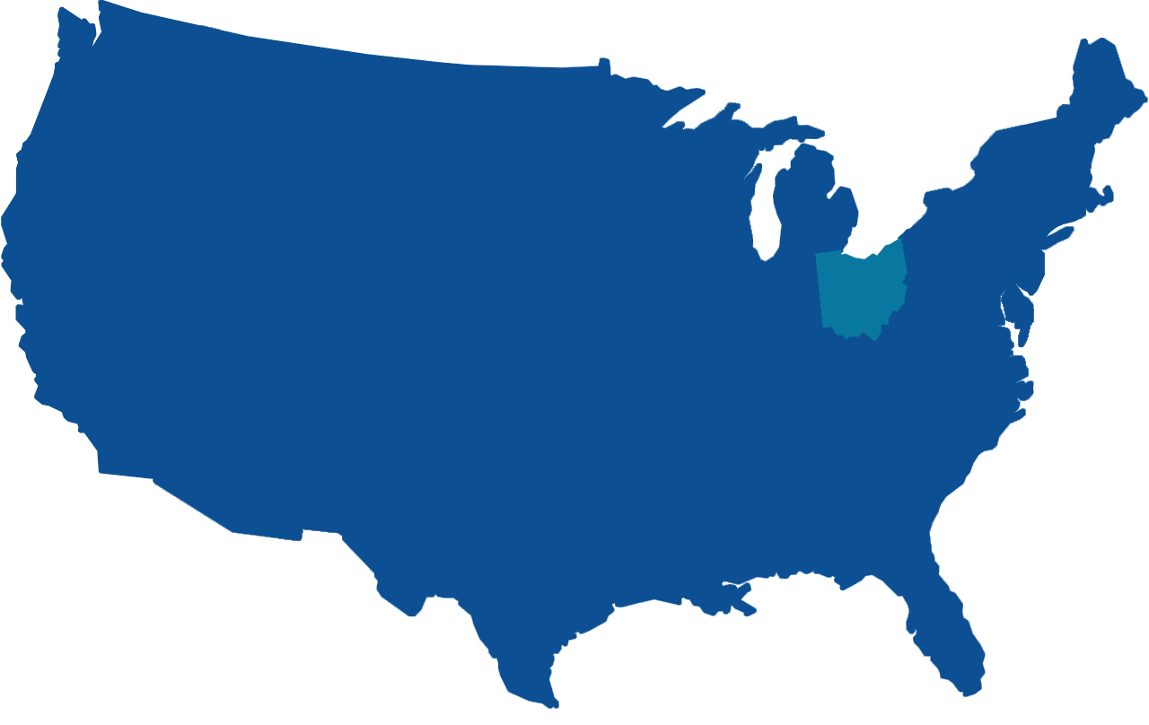
Ohio Casino Availability in 1980
Atlantic City
Las Vegas
Notes:
Cleveland to Atlantic City – 415 miles
Cincinnati to Las Vegas – 2105 miles
People had to travel far to gamble

Slide 6
Ohio Casino Availability in 2010
Notes:
Neighboring states

Slide 7
Hollywood Casino
JACK Cleveland Casino
-betJack at Jack Cleveland
-betJACK at JACK Thistledown
-BetMGM at Northfield Park
-Casears Sportsbook at Rocket Mortgage Field House
-Barstool Sportsbook at Hollywood Casino Toledo
- JACK Thistledown
- MGM Northfield
-Barstool Sportsbook at Hollywood Casino
-Caesars Sportsbook at Scioto Downs Racino
-Barstool Sportsbook at Hollywood Gaming at Mahoning Valley
Hollywood Casino
Hollywood at the Mahoning Valley Racecourse
-Barstool Sportsbook at Hollywood Casino Dayton Raceway
Scioto Downs
Hollywood at the Dayton Raceway
Miami Valley Gaming
JACK Cincinnati Casino
Belterra Park Gaming & Entertainment Center
-Belterra Park Fan Dual Sports Book
-Bet MGM Cincinnati Reds at the Machine Room
-FC Cincinnati at Taft's Ale House
-Hard Rock Cincinnati Digital

Slide 8
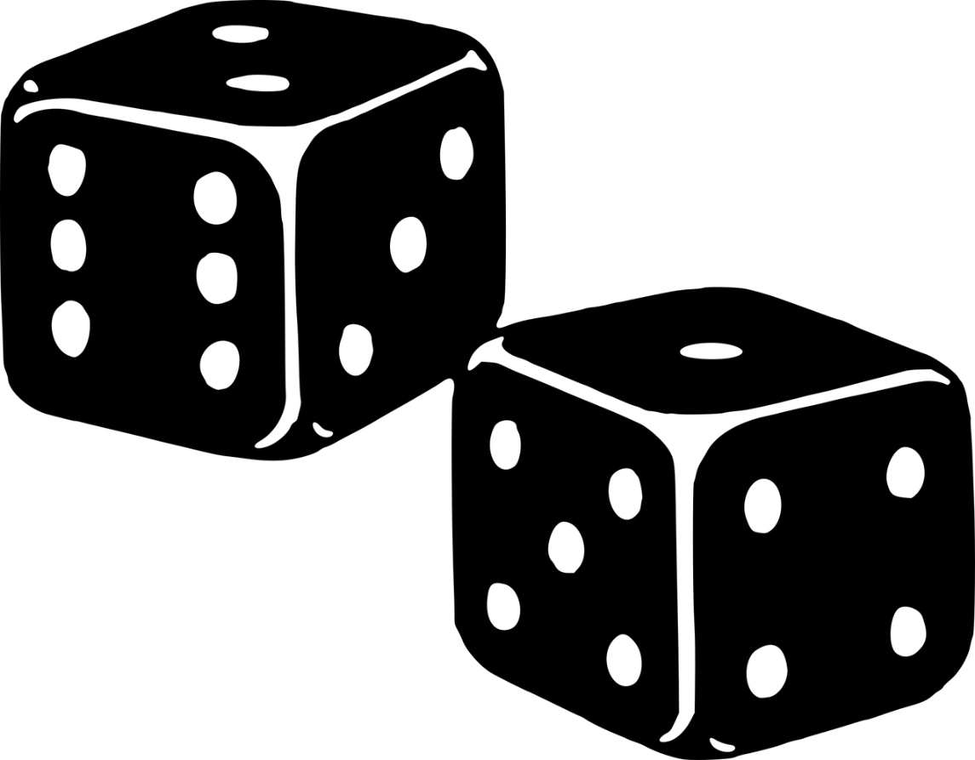
What is Gambling?
Gambling, Types of Gambling Activities, DSM Development

Slide 9
How would you define gambling?
Notes:
Please post in the chat how you would define gambling

Slide 10
What is Gambling?
Gambling is risking something of value on an event that is determined mostly by chance.
DSM-5: Risking something of value in the hopes of obtaining something of greater value.
Gamblers Anonymous: Any betting or wagering, for self or others, whether for money or not, no matter how slight or insignificant, where the outcome is uncertain or depends upon chance or “skill” constitutes gambling.
Notes:
Is the bet itself the thrill? Or the sought reward?

Slide 11
Types of Gambling Activities
Lottery
Sports betting
Slot Machine or VLT
Card and table games
Horse betting
Dice games
Video Gaming
Fantasy Sports
Notes:
VLT – Video Lottery Terminal
Running Numbers
Internet Gambling
Day Trading – Stocks

Slide 12
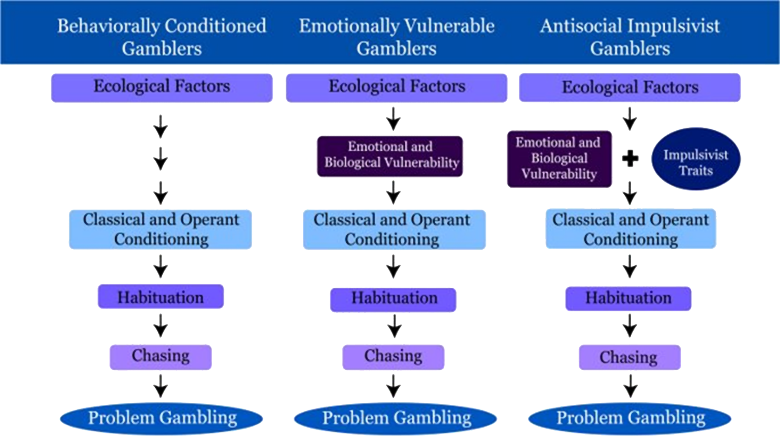
Pathways Model
Notes:
•Behavioral Conditioned Gambler
Convinced they have a system
High Illusion of Control and Fallacies
Low sensation seeking low depression
Maintained by environmental contingencies
•Emotionally Vulnerable Gambler
Alexithymia (uh-lek-suh-thai-mee-uh) – difficulty recognizing emotions
Low impulsivity, High Depression, past trauma, poor coping
•Antisocial Impulsive Gambler
High sensation seeking, impulsivity, depression
Alexithymia

Slide 13
Problem Gambling
Gambling is a problem when it disrupts or damages your:
Mental, physical health
Emotional, social, spiritual health
work, school or other activities
relationships
finances
reputation
Notes:
When it is not a disorder, PG can still be a problem. Combination of beliefs and behaviors that impact us and those around us

Slide 14
Risks & Predictors

Slide 15
Predictor of Problem Gambling
Early big win
Gambling type
Electronic Gaming Machine vs. Table Game
Availability of opportunities
Family History/acceptance/attitudes
Alcohol an/or other drug use
Gambling Fallacies – superstition, false beliefs

Slide 16
Warning Signs
Spending more than intended (time and money)
Hiding Bills
Pawning/selling items
Lying about involvement or frequency and amount spent
Exaggerating wins/understating loses
Not able to stop thinking/talking about gambling
Replacing family/friends/old hobbies with gambling
Distressed/depressed
Extreme agitation when asked about gambling
Demographics
African American at-risk
Men higher risk over women

Slide 17
Responsible Gambling
Set Limits
Gamble with Money Set Aside
Balance
Know the Risks
Keep it a social activity
Bet on only what you can afford to lose
When to quit – when to step away
Notes:
Knowing more won’t guarantee a win
Never borrow to play
Everyone loses over time
Play for fun, not just money
Never gamble when stressed, depressed or in recovery
Don’t play to escape
Avoid using alcohol and other drugs while gambling
Know what’s legal
Know where to get help

Slide 18
Impact & Scope

Slide 19
Gambling Impact
Mental health
Absent
Job Loss
Stress
Suicide
Performance
Work & Study
Personal
Poor Health
Impacts
Hardship
Loads on Charities
Community Services
Financial
Debts
Loads on public purse
Bankruptcy
Asset Loss
Neglect
Interpersonal
Legal
Loan Shark
Impact
Theft
Imprisonment
Relationship Break
Violence

Slide 20
Diagnostic and Statistical Manual of Mental Disorders (DSM-5)
Is often preoccupied with gambling.
Needs to gamble with increasing amounts of money to achieve the desired effect.
Repeated, unsuccessful efforts to control, cut back, or stop gambling.
Restless/irritable when attempting to cut down or stop gambling.
Gambles when distressed.
“Chasing” losses.
Lies to conceal the extent of involvement with gambling.
Has jeopardized or lost a significant relationship, or educational/career opportunity.
Relies on others to provide money to relieve a desperate financial situation caused by gambling.
Has committed illegal acts.
Mild: 4-5 criteria Moderate: 6-7 criteria Severe: 8-9 criteria

Slide 21
Disordered Gambling and Co-Occurring Conditions
Problem gambling releases dopamine from the same part of our brain as substance use, the hypothalamus
Clients can transfer their addiction from one substance to another substance and/or behavior
Challenging to identify gambling addiction because there is no urine or blood test
Ex: A person with the substance addiction begins to buy and obsess over lottery tickets when they used to drink

Slide 22
How to Integrate Problem Gambling
Include gambling screenings in basic needs screening
Share problem gambling awareness with the collogues and the community
Provide education programming and/or connect with local agencies that specialize in problem gambling
Provide prevention materials to clients in waiting areas (Ex: handouts/pamphlets)
Provide the problem gambling hotline number for any events considered gambling (Ex: Raffles, auctions, March Madness)

Slide 23
At-Risk Populations
College Age
Senior
Asian population
Veterans
Individuals in Recovery

Slide 24
Screening Tools
What tools are available?

Slide 25
Gambling Screening Tools
Tools available:
South Oaks Gambling Screen (SOGS)
National Opinion Research Center DSM Screen for Gambling Problems (NODS)
Diagnostic and Statistical Manual of Mental Disorders 5th addition (DSM-5)
Brief Bio-Social Gambling Screen (BBGS)
Tools we at Recovery Resources/Probation Court currently use:
Brief Biosocial Gambling Screen (BBGS)
Diagnostic and Statistical Manual of Mental Disorders (DSM-5)
Notes:
NABIL
These are some of the things you would see in each of these screens:
SOGS – less than once a week, once a week or more questions, discussing amount gambled in a day, family history, chasing losses, exagerating wins and losses, discuss if they feel they have a problem, frequency, being criticized, guilt, couldn’t stop, hiding gambling, arguments
NODS – NODS Clip, 3 questions, 2 weeks or more thinking about gambling, trying to stop, lying about gambling?
BBGS – BBGS, BBGS 3item, BBGS 5 item – last 12 months restless, keeping family from knowling, financial support from loved ones to support gambling; needing to gambling larger amounts, frequency, tried to cut down to control self; preoccupied, larger amounts gambled, frequency, cut down control, borrow
DSM 5

Slide 26
Gambling Screening Tools
Brief screens consist of 2-3 questions, which typically take less than a minute to answer. Important when screening to think about these 4 concepts below.
Sensitivity
Specificity
Positive Predictive Value
Negative Predictive Value
Notes:
NABIL
Sensitivity refers to how well the tool correctly identifies individuals with problem gambling
• Specificity refers to how well the tool identifies individuals that do not have problem gambling
• Positive Predictive Value (PPV) reflects the likelihood that a person who has a positive screening test actually has problem gambling
• Negative Predictive Value (NPV) reflects the likelihood that a person with a negative screening test does not have problem gambling

Slide 27
Brief Biosocial Gambling Screen (BBGS)
During the past 12 months, have you become restless, irritable, or anxious when trying to stop/cut down on gambling?
Yes or No
During the past 12 months, have you tried to keep your friends or family from knowing how much you gambled?
Yes or No
During the past 12 months, did you have such financial trouble as a result of your gambling that you had to get help with living expenses from family, friends, or welfare?
Yes or No
Notes:
NABIL
A “yes” answer to any of the questions means the person is at risk for developing a gambling problem; continue with full screen to assess risk level. If negative, reinforce healthy decisions and continue with appointment.
A PPV of 0.74 suggests that 74% of individuals who screen positive on the BBGS will be identified as a problem gambler

Slide 28
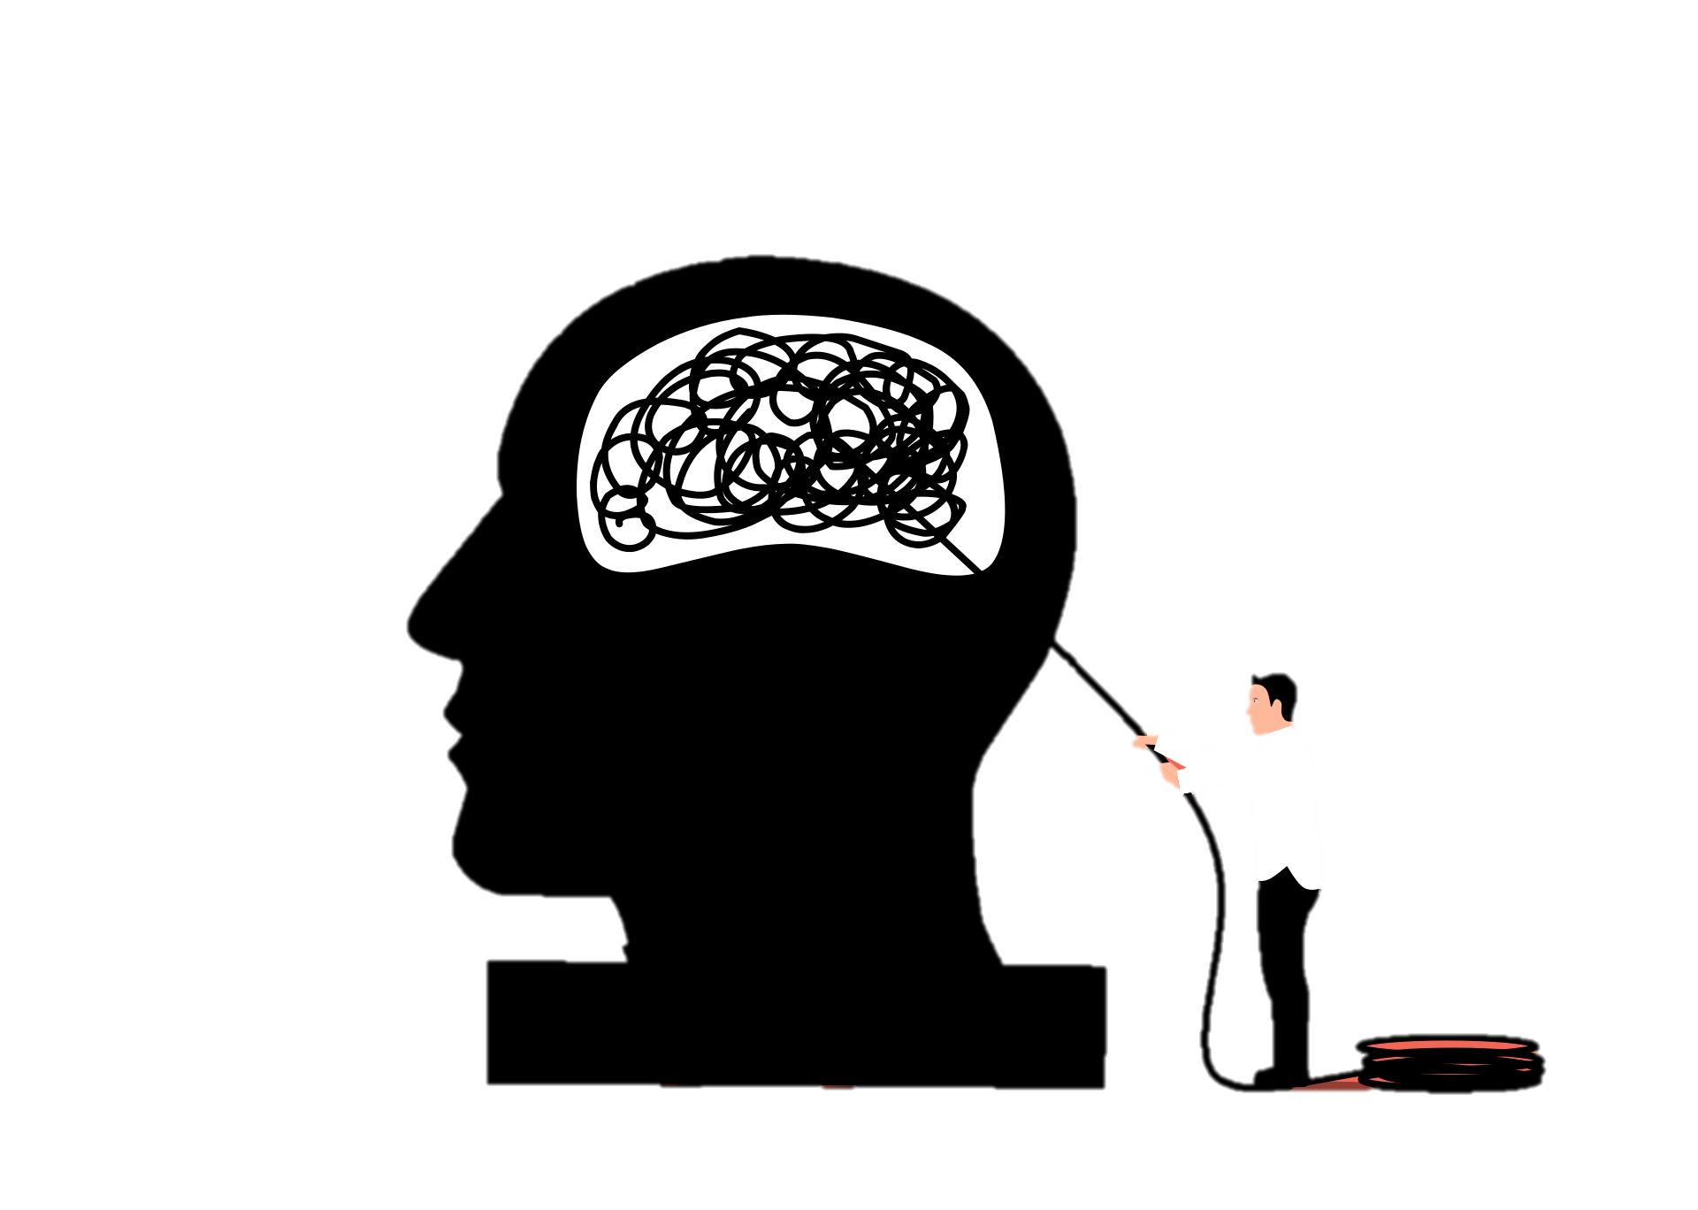
DSM-5 and Gambling Disorder
The American Psychiatric Association has guidelines for gambling disorder within the DSM-5.
Problem Gambling is loss of control over gambling, preoccupation with gambling, irrational thoughts associated with gambling and continued gambling behavior despite negative consequences
Notes:
NABIL
Gambling was adjusted in 2013 in the DSM-5 from pathological gambling to gambling disorder.
Persistent and recurrent problematic gambling behavior leading to clinically significant impairment or distress, as indicated by the individual exhibiting four (or more) of the following in a 12­month period – There are about 9 criteria. The guidelines ask to specify if:
Episodic – meeting criteria for more than one time point with symptoms subsiding between periods of gambling disorder for at least several months.
Persistent – continuous symptoms, meet criteria for multiple years
Early remission – after gambling disorder criteria were previously met but now no criteria for at least 3 month but less than 12. Sustained remission is 12 months or longer.

Slide 29
Diagnostic and Statistical Manual of Mental Disorders (DSM-5) Criteria
Is often preoccupied with gambling.
Needs to gamble with increasing amounts of money in order to achieve the desired effect.
Repeated, unsuccessful efforts to control, cut back, or stop gambling.
Restless/irritable when attempting to cut down or stop gambling.
Gambles when distressed.
“Chasing” losses.
Lies to conceal the extent of involvement with gambling.
Has jeopardized or lost a significant relationship, or educational/career opportunity.
Relies on others to provide money to relieve a desperate financial situation caused by gambling.
Has committed illegal acts.
Mild: 4-5 criteria Moderate: 6-7 criteria Severe: 8-9 criteria
Notes:
NABIL

Slide 30
Group Activity
True or False

Slide 31
If a problem gambler builds up a debt, you should not help them take care of it.
Notes:
Emily

Slide 32
TRUE
Quick fix solutions may appear to be the right thing to do. However, bailing the gambler out of debt may actually make matters worse by enabling gambling problems to continue.
Notes:
Lauren

Slide 33
Partners of problem gamblers often drive problem gamblers to gamble.
Notes:
Emily

Slide 34
FALSE
Problem gamblers often rationalize their behaviors. Blaming others is one way to avoid taking responsibility for their actions, including what is needed to overcome the problem.
Notes:
Lauren

Slide 35
Legalized forms of gambling are safe.
Notes:
Emily

Slide 36
FALSE
Gambling is frequently portrayed in the media as entertaining and harmless, without a balanced portrayal of the risks or potential negative consequences. In fact, we live in a culture which encourages an activity that destroys a percentage of the lives it touches. No other addiction offers a jackpot if you participate.
Notes:
Lauren

Slide 37
It’s harmless for children to gamble.
Notes:
Emily

Slide 38
FALSE
Gambling as a child may increase the likelihood of gambling in adulthood. On average, problem gamblers say they began gambling at about 10 years of age.
Notes:
Lauren

Slide 39
Gambling Trends
Sports betting, iGaming, and Loot Boxes

Slide 40
Emerging Trends
iGaming
Loot Boxes/Video Games
Metaverse

Slide 41
iGaming
Online betting that wagers on events based on chance
Legalization increase globally
Worth an estimated $66.7 billion per year
EX: Sports betting, online table games, online casinos, mobile gaming

Slide 42
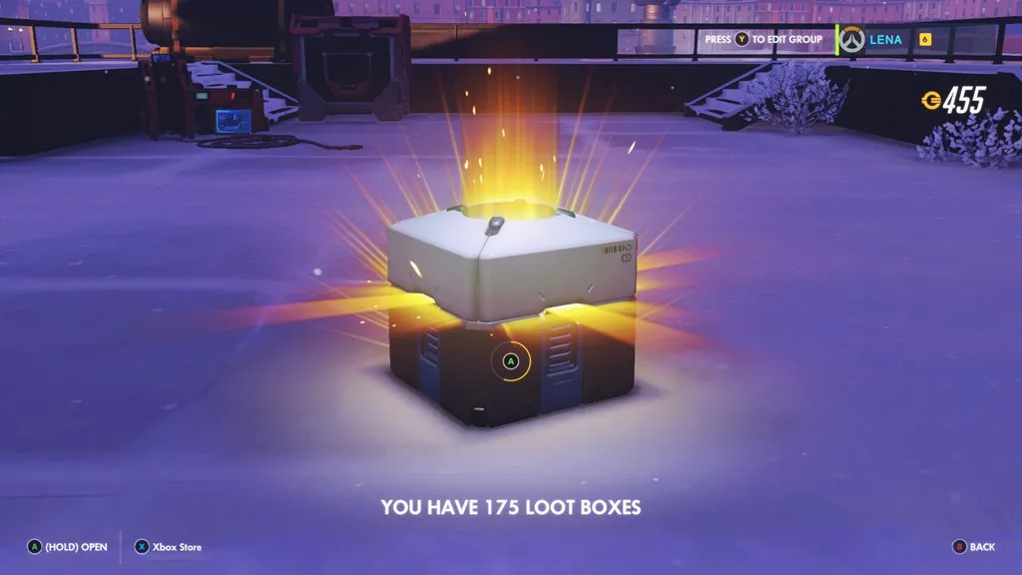
Loot Boxes & Video Games
Gambling elements of video games
Opportunities for players to win items (ex: powerful weapons and/or skins (outfits)
Legislation in other countries to ban in popular games
Can be found in Apex Legends, Overwatch, Star Wars Battlefront II, FIFA 19, Middle-earth: Shadow of War, Gears of War 4 and Halo 5: Guardians.
Tomsguide.com

Slide 43
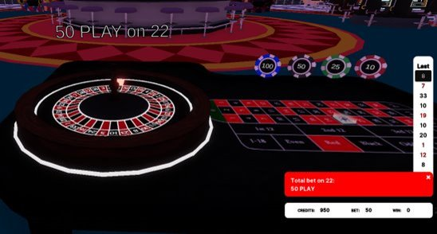
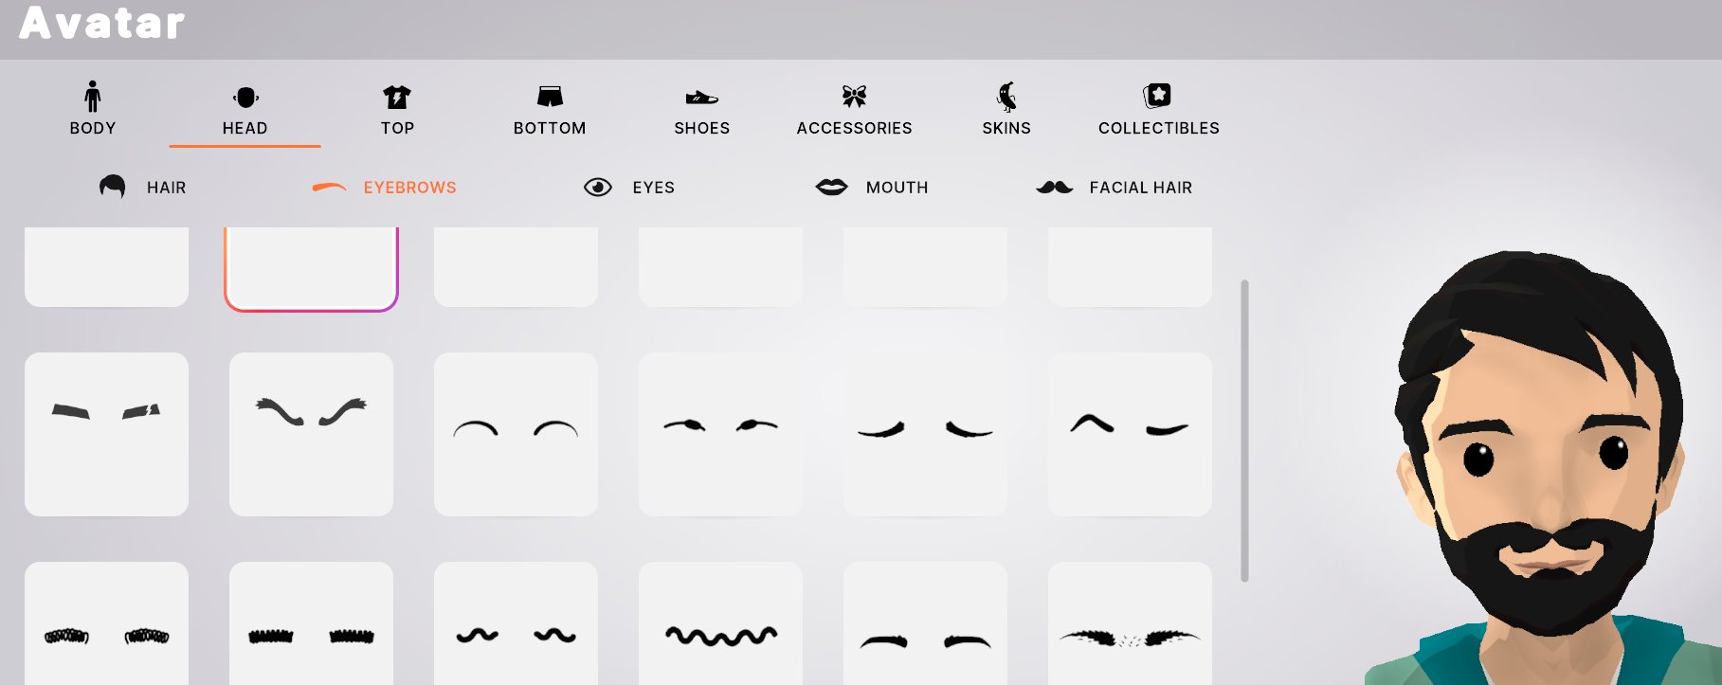
Metaverse
Virtual Reality Casinos
Create an Avatar (realistic or
Anonymous)
Few to no age requirements
Gamble with cryptocurrency and
Virtual wallets
Free play offered

Slide 44
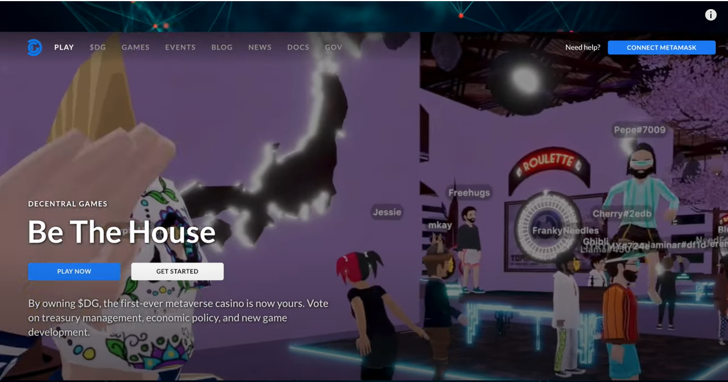
Notes:
***NABIL***
According to business insider, within the first three months the casino made $7.5 million which accounts for about 1/3 of daily users in decentraland.
More recently less people hop into decentraland – but 60% focus their time in caisnos
https://markets.businessinsider.com/news/currencies/decentraland-metaverse-casino-crypto-gambling-poker-2022-2

Slide 45
How to Have the Conversation
Best Approaches for friends and family

Slide 46
How to Have the Conversation
It is a Public Health issue
It effects all aspects of health – physical, social, mental
It effects all aspects of life – family, work, finances, reputation
Gambling Disorder does not discriminate
Problems can develop from any form – lottery, sports, video gaming, etc
It is Preventable, Identifiable, Treatable
There is Help!

Slide 47
Bringing it all Together
Food for Thought, Key Takeaways , and Resources

Slide 48
Food for Thought
How recent legalization and emerging have changed the way we approach gambling screening, prevention, and treatment
Gambling can be seen all throughout our society, common practices at community centers and religious centers
What are the best ways to screen and talk to our clients about gambling as a topic

Slide 49
Key Takeaways
Legalization and emerging trends has changed the landscape of gambling and risk of problem gambling
The definition of gambling is broad and applies to a variety of activities (ex: Auctions, lottery)
Youth have increased access to gambling through video games, apps, Metaverse gambling

Slide 50
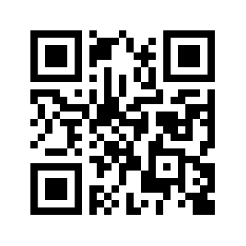
For more information go to www.recres.org/cpgc

Slide 51
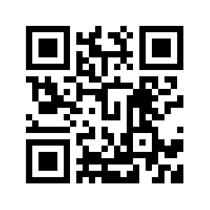
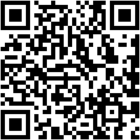
For more information go to www.beforeyoubet.org
For more information go to www.changethegameohio.org
Notes:
Here you can find
Tips and education
Marketing materials
Testimonials
Online quiz
And
Change the Game program
Smart Gaming presentations in Schools (Middle school, High school, College)

Slide 52
Resources: Other Resources
Ohio for Responsible Gambling
Ohio Mental Health and Addiction Services
Problem Gambling Network of Ohio
Ohio Problem Gambling Hotline:
1-800-589-9966

Slide 53
Resources
https://www.forbes.com/sites/zackjones/2021/04/21/the-rise-of-the-igaming-industry-what-is-in-store-for-the-citizens-of-united-states/
What Are Loot Boxes? Gaming's Big New Problem, Explained | Tom's Guide (tomsguide.com)
https://www.apa.org/monitor/2023/07/how-gambling-affects-the-brain

Slide 54
Call us at 216.431.4131
Lakewood Office:
14805 Detroit Rd. Suite 200 Lakewood, OH
Old Brooklyn Office:
4269 Pearl Rd Cleveland, OH
My Contact:
Nora C. Larson (she/her), M.Ed. CHES® OCPS
Gambling Services Coordinator
Nlarson@recres.org
Direct: 216-923-1248

