Slide 1


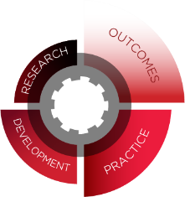

UNIVERSITY OF CINCINNATI
CORRECTIONS INSTITUTE
CCP
Core Correctional Practice

Slide 2
Core Correctional Practice
University of Cincinnati
Corrections Institute
www.uc.edu/corrections
To develop, disseminate, and implement best practices in the field of corrections.
Notes:
Discuss housekeeping items: restrooms, breaks, general agenda, any announcements, etc..
Conduct introductions – consider use of an ice breaker. If the group is larger, keep length of time in mind when doing introductions if using an ice breaker. This will take approximately 30 minutes for a group of 30.
Note that the material is copyright protected. They can use the items and make copies for their work with their clients, but are not permitted to share with other agencies or make modifications.

Slide 3
Learning Objectives
Briefly review the principles of effective intervention
Define structured learning
Review examples of how structured learning can be applied to specific skills
Notes:
This training compares effective programs (those most likely to reduce program person recidivism) to ineffective ones (those which either do not change program person behavior or those which may even increase the program person’s likelihood of committing new offenses).
It also explores the strategies or best practices to effect change in those we work with. These principles are known as the Principles of Effective Intervention.
Finally, we explore ways to work with correctional persons to reduce their risk of reoffending. All staff play a role in reducing risk and the research shows that we are most effective when we all operate out of a set of Core Correctional Practice. We will be learning 8 skills and will practice using them during the course of the training. We will conclude by discussing how to use the skills in our day to day interactions with individuals.

Slide 4
Evidence-Based Practice
Notes:
Placeholder slide

Slide 5
Evidence-Based Practice
A practice that has been shown to work
through use of scientific research
Anecdotal Evidence
Empirical Evidence
Notes:
There is a continuum of evidence. The lowest form is anecdotal. This includes personal experiences of what works. This may not be consistently reliable and may be explained by extraneous factors rather than the specific interventions (e.g., individual’s strengths, relationship, other interventions, etc.). This often gives a good feeling, but may not result in sustained or internal change.
The highest form of evidence is empirical. This includes research from a controlled study. Sometimes this is not as enjoyable and does not result in “feel goods.”

Slide 6
Evidence-Based Practice
Think of as Evidence-Based Decision Making
Process for making decisions that is
grounded in the best available evidence
Understanding Evidence: Evidence Based Decision-Making. (n.d.). Retrieved April 17, 2019, from https://vetoviolence.cdc.gov/
Notes:
Evidence Based Decision-Making is a process for making decisions about a program, practice, or policy that is grounded in the best available research evidence and informed by experiential evidence from the field and relevant contextual evidence.
Understanding Evidence: Evidence Based Decision-Making. (n.d.). Retrieved April 17, 2019, from https://vetoviolence.cdc.gov/

Slide 7
The Principles of Effective Intervention
Evidence-Based Practice:
Notes:
The Principles of Effective Intervention: How do we put the research into practice?
The Principles of Effective Intervention are a set of instructions on how to design programs and make decisions when we are dealing with persons while they are involved in the criminal justice system.
These principles should be applied by the courts, community supervision and community based programs, institutions (prisons, jails, detention), and outpatient programs.
These principles have been shown to apply with all segments of offenders groups . . .
Adults and youth
Males and females
Felony and misdemeanor

Slide 8
The Principles of
Effective Intervention
WHO
NEED
WHAT
RESPONSIVITY
HOW
RISK
Notes:
This slide is meant to briefly introduce each of the principles. You will go into much more detail in the upcoming slides.
Quickly indicate the core principles of effective intervention: Risk is who we target, Need is what we target, and Responsivity is how we target the needs. This is referred to as RNR.

Slide 9
The Principles of
Effective Intervention
NEED
WHAT
RESPONSIVITY
HOW
RISK
WHO
Notes:
Introduce the risk principle

Slide 10
Risk Principle: Overview
Tells us “who” to target
Risk level determine risk by validated risk tool
Match interventions and supervision to risk level
Remember: We look at the risk of reoffending, not the severity of the crime.
Notes:
Risk refers to the likelihood of reoffending. The risk principle identifies “who” should be in our programs and who will benefit from the most intensive services and programming.
We identify a person’s risk level by using a validated risk tool. Most tools categorize people into low, moderate, or high risk for reoffending. Once we have identified the person’s risk levels, we can then match them to interventions and supervision levels that are appropriate to their level of risk. Who do you think needs more intensive supervision or intervention? Low, moderate, or high?
Do you think there are low, moderate, and high risk sexual offenders, murderers, etc..? Discuss that it is not the severity of the crime, it’s the likelihood of reoffending.
The risk principle applies to everyone. Sometimes we need to use additional tools to address risk of specific types of crimes (e.g., sexual offending, violence, domestic violence). The general risk tool is still relevant because some offenders may be involved in general criminal conduct in addition to the specific instant offense.
The risk principle states that intensive programming should be focused primarily on higher risk persons. The reason is simple: they have the highest risk of re-offending. Consider using an example – if you have two offenders, one is high risk and one is low risk . . . . Who is likely to go get help from a community provider? Who is more likely to get into risky behavior? If they were both at your house and in different rooms – who would you watch?

Slide 11
Risk Principle: Key Elements
Target people with higher probability of recidivism
Provide most intensive intervention to higher risk individuals
Intensive intervention can harm people at lower risk
Notes:
There are three elements to the Risk Principle:
The risk principle stipulates that people should be matched to supervision level and intervention based on their level of risk.
Provide most intensive intervention to higher risk people. High risk need more and moderate need less.
Intensive intervention for lower risk people can increase recidivism. Why?
1. Expose them to higher risk people and they learn more antisocial attitudes and behaviors.
2. Disrupt protective factors that make them low risk in the first place – what do you think those are? employment, education, family support, etc..
3. Involving them deeper into the criminal justice system may create an us vs them
4. Contributes to more societal discrimination and self-identification as a criminal
Use relatable analogies or examples:
Would you let your kid hang out with those kids that get into a lot of trouble? Why not?
If you have a basket of dirty sweatshirts, and throw in a clean shirt . . Does the clean one stay clean? No
If you have a clean basket of sweatshirts and throw in a dirty one . . Does the dirty one get clean?
Have you ever had a pretty functioning unit or group and add one or two high risk offenders – who has the greater influence?

Slide 12


10 High Risk Offenders
No EBP
EBP
10 Low Risk Offenders
No EBP
EBP
Notes:
Use this illustration to demonstrate the risk principle (not a research study, but averages based on risk assessment cut offs)
If you have 10 High risk offenders about 60% will fail
If you put them in well designed EBP for sufficient duration you may reduce failure rate to 40%
If you have 10 low risk offenders about 10% will fail
If you put them in same program you may increase the failure rate to 20%

Slide 13
Intervening by Risk Level
Low Risk
High Risk
Fewer and less intensive programs
Less restrictive supervision
Fewer areas of risk
Are likely to “self-correct” behavior
More likely to reoffend
More restrictive and structured supervision
More areas of risk
Interventions and services should be longer in duration
Notes:
When looking at these two lists what do you notice?
Low risk need LESS
Low risk persons have fewer risk areas and often have many protective factors that can assist them to succeed. Examples of protective factors include: having a prosocial family, good performance in school or job, positive recreational outlets, positive relationship with significant other, and no alcohol or drug problems. When case planning, remember services and interventions should be less restrictive for this population.
High risk need MORE
On the other hand, high risk people are more likely to reoffend without intervention and require different strategies than the low risk population. When developing case plans or supervising units, remember high risk individuals have more risk areas which require longer and more intense structured supervision.
Mixing makes LOW Worse
One important note taken from the risk principle is that high risk people should not be mixed in any setting with low risk persons. Research supports that high risk individuals are more likely to influence the low risk individuals and increase their chances of reoffending.

Slide 14
The Principles of
Effective Intervention
RISK
WHO
NEED
WHAT
RESPONSIVITY
HOW
Notes:
Introduce the need principle.

Slide 15
Need Principle: Overview
Tells us “what” to target
Criminogenic needs = Dynamic risks
Focus on criminogenic needs determine by validated tool
Notes:
The second principle is known as the need principle and speaks to the issue of “what” to target.
Interventions will be most effective if they are focused on the specific need areas for the individual. Most validated risk assessments identify the specific problem areas of the persons. These are called criminogenic needs – or crime producing needs. Addressing these areas has been shown to reduce reoffending.

Slide 16
Need Principle: Key Elements
Focus density of services on criminogenic needs
Individualize services by targeting moderate and high need areas
Notes:
These two principles will be expanded upon over the next few slides.

Slide 17






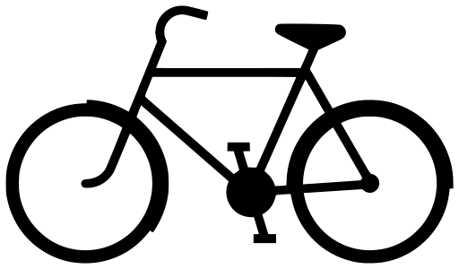
Need Principle: Key Targets
History of Antisocial Behavior (Static Risk Factor) | Antisocial Cognition | Antisocial Associates | Antisocial Personality Pattern
Family/Marital Circumstances | School/ Work | Substance Abuse | Leisure/ Recreation
Notes:
Criminogenic risk includes both static and dynamic factors. These factors are also known as ”The Central 8.”
Static factors increase an individual’s risk of reoffending but cannot change. For example, criminal history, current age, age at first arrest.
Dynamic risk factors are those factors that can change, for example someone’s values and beliefs, substance abuse, peers, etc..
The criminogenic risk/need factors all influence recidivism – use the risk assessment to identify what domains to target.
Attitudes play a key role in whether a person engages in offender behavior.
Example: if you lost your job today – what would you do? Look for a new job, complete your resume, check with past employers, network with friends, etc.. If an offender loses their job, many times they resort to criminal behavior for income if they have attitudes that say: “Work is for losers, I can make more money selling drugs in a day than you make all week”, etc..
Define each of the criminogenic needs and elicit examples for each one.
Attitudes, values, and beliefs – I am better than others, It’s not a big deal, It’s not wrong if you don’t get caught, It’s not my fault, I deserve to be given what I want, negative view of authority, conventional behavior is lame, etc..
Peer associates – spending time with antisocial peers and lacking prosocial friends and acquaintances.
Personality factors: impulsivity, self-centered, risk taking, aggressive or hostile, low empathy, weak socialization and problem solving skills, and poor self-control.
Education/Employment - Low levels of personal, educational, vocational, and financial achievement
Family factors, including criminal behavior in the immediate family, low levels of affection, poor parental supervision.
Abuse of alcohol and/or other drugs: This often allows for contact with antisocial peers, can impact social skills, and, in the case of illicit drugs, is illegal in and of itself. They use illegal means to obtain alcohol or other drugs.
Low level of involvement in prosocial leisure activities and engaging in antisocial activities. Too much unstructured free time.

Slide 18
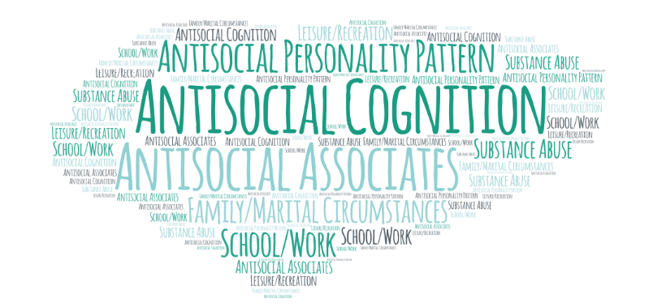
People are high risk because they have multiple needs
Notes:
Programs that target only one need may not produce the desired effects. We need to target all their needs. We can do that by helping them pick risky situations that related to the identified criminogenic needs when we are meeting with them individually or when selecting practice situations in groups.

Slide 19
The Principles of
Effective Intervention
RISK
WHO
NEED
WHAT
RESPONSIVITY
HOW
Notes:
Introduce the responsivity principle

Slide 20
Responsivity Principle: Overview
Tells us “how” to change behavior
Specific Responsivity: Match individuals to interventions and staff based on key personal characteristics
General Responsivity: Most effective interventions are based on cognitive, behavioral, and social learning theories
Notes:
The responsivity principle tells us how to target the criminogenic needs of higher risk persons. There are two parts to this principle: general and specific.
General responsivity tells us to provide interventions that persons in general will respond well to, like cognitive-behavioral strategies. Specific responsivity tell us to match the styles and mode of service to key person characteristics and learning styles.

Slide 21
Specific Responsivity
Match programs and interventions based on individual needs
Identify and play into strengths
Identify and remove barriers
Notes:
You will expand on these concepts in the next few slides.

Slide 22

Specific Responsivity:
External Considerations
Transportation
Child Care
Housing
Financial
Physical Health Conditions
System-Created Barriers
Photo by Matthew Hamilton on Unsplash
Notes:
Several of these factors can interfere with the client accessing the content. For example, if someone cannot get a ride to group, they cannot be successful.
While these factors are not criminogenic needs, we may need to address them if they are a barrier to engagement and benefit from treatment. We will be talking about this in the next segment of the training (specific responsivity).

Slide 23
Specific Responsivity:
Internal Considerations
Motivation
Mental Illness
Trauma
Gender Identity
Age
Maturity
Ethnicity
Culture
Cognitive Skills
Notes:
Several of these factors can interfere with the client benefitting from programming. Addressing these factors without targeting criminogenic needs will unlikely lead to a reduction in recidivism.
For example, if someone is seriously depressed, they may not attend group or be able to concentrate on the content.
Others may be a factor in leading them down the path to criminal behavior. For example, if someone has a history of abuse, they may self-medicate with substances and choose unhealthy partners. This exposes them to additional risks and influences their subsequent lifestyle choices.
Some of these elements may improve as the person develops a prosocial lifestyle – self-esteem improves as one begins earning respect, working and supporting self, living more congruent to values, etc.. A healthy lifestyle may develop with prosocial living.
While these factors are not criminogenic needs, we may need to address them if they are a barrier to engagement and benefit from treatment. We will be talking about this in the next segment of the training (specific responsivity).

Slide 24
General Responsivity
Use evidence-based approaches
Interventions based on behavioral, cognitive-behavioral and social learning theories are most effective with justice-involved population
Notes:
General responsivity means:
Most effective approaches to changing person behavior are behavioral interventions
Structured social learning programs where new skills are taught
prosocial behaviors and attitudes are reinforced
Cognitive-behavioral programs that target things such as attitudes, values, peers, substance use, or anger.
There are a number of cognitive-behavioral interventions for groups (Thinking for a Change, Aggression Replacement Training, Cognitive Behavioral Interventions by UCCI)
Core Correctional Practice is cognitive-behavioral interventions delivered by staff in often unplanned everyday situations in in individual appointments

Slide 25
Fidelity and Program Integrity
Evidence-Based Practice:
Notes:
While we have a lot of information about the principles of effective intervention, it doesn’t matter unless we put it into practice.
We need to implement these principles in programming and deliver services as they were designed and intended.
The fidelity principle considers How Well we are implementing the model.

Slide 26

Fidelity
“How well” programs incorporate risk, need, and responsivity
Am I doing what I am supposed to be doing?
Notes:
Program integrity = how closely programs align to the program design
Questions we want to ask ourselves are:
Are we admitting higher risk persons?
Do we vary treatment by risk level?
Are we delivering as much dosage as we can?
Do we have more services targeting criminogenic needs than non-criminogenic needs?
Are we targeting the risk areas for the individuals and not including persons in groups that are not relevant for them?
Are we operating within a positive environment that promotes change and learning?
Are we addressing barriers when we are able?
Staff are responsible for implementing the program correctly. When implementing an intervention, we want to ensure that it’s being delivered as closely as possible to the way it was designed. This is called fidelity. Merriam Webster defines fidelity as: the degree to which something matches or copies something else.

Slide 27
Fidelity and Program Drift
Accidental adaptation can pose significant problems
Too much adaptation might decrease effectiveness
Notes:
Maintaining fidelity can be tiresome and difficult in some situations, and some drift is inevitable. Drift refers to those habits we form when we are not implementing an intervention to our best ability. Drift can result from burnout, or from adapting to our roles in such a way that is not according to best practices.
Although some drift is inevitable, if we are not aware of it (or do not catch it and fix it), we can have major problems. Essentially, our interventions may cease to be effective.
While adaptation of some interventions is necessary to address specific responsivity factors, too much adaptation may reduce effectiveness.
Examples:
A facilitator grows bored with teaching skill steps and starts to skip that part of the curriculum. The participants no longer learn the steps of each skill.

Slide 28
Fidelity: Summary
Fidelity is related to successful outcomes (i.e., recidivism reductions)
Poor fidelity can lead to no improvement or even negative effects
Fidelity cannot be assumed
Fidelity can be measured and monitored
Notes:
This is a summary slide – just quickly review the points.

Slide 29
Core Correctional PracticeS
Evidence-Based Practice:
Notes:
Introduce that you will be introducing the first 4 Core Correctional Practice.
This basic set of skills is probably not new to you. Rather the description of the skills has been streamlined specifically for criminal justice involved individuals to get maximum effect.
Having specific skills:
Builds confidence that we are responding effectively
Creates consistency in the program environment
Builds security and predictability for persons
People feel safer and less on guard when they know what to expect. This results in a safer environment.

Slide 30
Core Correctional Practice
Components of effective correctional practice designed to increase the therapeutic potential of rehabilitation programs
Use of CCPs is associated with greater reductions in recidivism
Andrews, D. A., & Kiessling, J. J. (1980). Program structure and effective correctional practices: A summary of the CaVIC research. In R.R. Ross & P. Gendreau (Eds.), Effective correctional treatment. Toronto, Canada: Butterworth.
Dowden, C., & Andrews, D. A. (2004). The importance of staff practice in delivering effective correctional treatment: A meta-analytic review of core correctional practice. International Journal of Offender Therapy and comparative criminology, 48(2), 203-214.
Notes:
This is a general definition to introduce CCP.
Historical context is on the next.

Slide 31

Core Correctional Practice (CCP)
Quality of Interpersonal Relationships
Effective Modeling
Effective Reinforcement
Cognitive Restructuring
Effective Disapproval
Structured Learning
Effective Use of Authority
Problem Solving
Photo by Hal Gatewood on Unsplash
Notes:
In the 1980s, Andrews and Keissling introduced Core Correctional Practice, commonly referred to as CCPs, as a way to increase the therapeutic potential of rehabilitation.
Research shows, if implemented properly, Core Correctional Practice can reduce recidivism by teaching persons how to engage in long-term prosocial behavior.
The 8 Core Correctional Practice are:
1. Quality of Interpersonal Relationships
2. Effective Reinforcement
3. Effective Disapproval
4. Effective Use of Authority
5. Effective Modeling
6. Cognitive Restructuring
7. Structured Learning/Skill Building
8. Problem Solving
Keep in mind that these are the technical terms for the CCPs. Your agency probably uses different language. Let’s look at each one and identify what term you actually use for the CCP.
These are also listed in your workbook on page 3.

Slide 32
CCP Produces Results
Use of CCPs improves success rates when adhering to RNR principles
Officers trained in CCPs produce better outcomes than untrained officers
Chadwick, N., Dewolf, A., & Serin, R. (2015). Effectively training community supervision officers: A meta-analytic review of the impact on offender outcome. Criminal justice and behavior, 42(10), 977-989.
Dowden, C., & Andrews, D. A. (2004). The importance of staff practice in delivering effective correctional treatment: A meta- analytic review of Core Correctional Practice. International Journal of Offender Therapy and Comparative Criminology, 48, 203-214. doi:10.1177/0306624X03257765
Notes:
Dowden and Andrews conducted a meta-analysis to examine the role of Core Correctional Practice in reducing recidivism. A total of 273 studies were included. Through the meta-analysis they found several things:
Very few of the programs used Core Correctional Practice.
Programs that did incorporate Core Correctional Practice, reported substantially better outcomes.
When Core Correctional Practice were combined with the principles of risk, need, and responsivity, the outcomes were even better.
Core Correctional Practice were found to be effective in different settings and across different person populations - this includes youth, adult, institution, and community populations.

Slide 33
CCP and Recidivism
0.5
0.4
0.3
No
Effect Size
Yes
0.2
0.1
Relationship
Skills
Structuring
Skills
Effective
Reinforcement
Effective
Modeling
Source: Gendreau, P. (2003). Invited Address, Division 18, APA Annual Convention, Toronto, CA.
Notes:
33
When CCP was applied, the program effectiveness greatly increased.
Note that when staff used the CCP skill compared to not using the skill the effectiveness was increased.

Slide 34
CCP and Recidivism
0.5
0.4
0.3
No
Effect Size
Yes
0.2
0.1
Effective
Disapproval
Structuring
Skill Learning
Problem
Solving
Effective
Authority
Source: Gendreau, P. (2003). Invited Address, Division 18, APA Annual Convention, Toronto, CA.
Notes:
34
The remainder of this training we will be targeting each of the skills identified in this study.

Slide 35
Core Correctional Practice (CCP)
Quality of Interpersonal Relationships
Effective Modeling
Effective Reinforcement
Cognitive Restructuring
Effective Disapproval
Structured Learning
Effective Use of Authority
Problem Solving
Photo by Hal Gatewood on Unsplash
Notes:
Introduce the next CCP skill – Structured Learning and Skill Building.

Slide 36
Structured Learning: Method to teach new skills in an organized, stepwise process
Notes:
36
This is the definition of structured learning.

Slide 37

Structured Learning
2. Model the skill
1. Define the skill
3. Practice the skill
6. Provide feedback
4. Provide feedback
5.Graduated Practice
Image by Clker-Free-Vector-Images from Pixabay
Notes:
This is a placeholder slide – each of these steps will be addressed in-depth in the following slides.

Slide 38

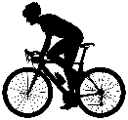
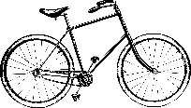
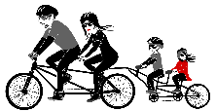
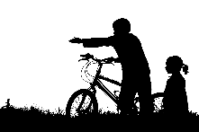
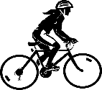
Structured Learning
Images from Pixabay

Slide 39


SKINNER
To enter, press lever.
PAVLOV
Knock. Do not ring bell. Dog inside.
BANDURA
Please watch video tape on how to knock.
Photo by Sophie Dale on Unsplash
Notes:
How do these theories apply? Let’s take a look at each one.
Who remembers B.F. Skinner and the Skinner’s Box? You may remember that he placed a rat in a box with a lever, and each time that rat pushed the lever, it received a food pellet. The rat learned to pushing the lever led to the reinforcement of food. According to Skinner, new behavior is learned through classical or operant conditioning (collectively known as 'learning theory’). He believed that our mind is 'tabula rasa’, or a blank slate when we are born.
Next to build on Skinner’s theory was Ivan Pavlov who gave us Classical Conditioning. Who remembers Pavlov’s dog and bell experiment? Pavlov accidentally discovered that he could link 2 stimuli together to produce a new learned response when he was researching salivation in dogs in response to being fed. He predicted the dogs would salivate in response to the food placed in front of them, but he noticed that his dogs would start to salivate whenever they heard the footsteps of his assistant who was bringing them the food. Through his research, he found that he could pair a conditioned stimulus, such as a bell, with an unconditioned stimulus, like the food, to create the conditioned response, salivating at the bell.
Finally, Albert Bandura helped us to see that there are environmental influences on learning. Bandura built upon classical and operant conditioning by identifying that we do not learn in a vacuum. We learn with all of our senses and observational learning happens. This is Social Learning Theory.

Slide 40
Role Play: Method to
practice new skills in a
controlled environment
Notes:
40
This is the definition of role play.
One strategy to teach persons new skills is to teach them through role play. There is a great deal of evidence to support that this is an effective method to teach skills and reduce risk.

Slide 41
Role Playing and Recidivism
Many justice-involved individuals lack social and emotion regulation skills
A recent study examined how dosage interacts with the use of role plays to influence recidivism
Sperber, K. G. & Lowenkamp, C. T. (2017). Dosage is more than just counting program hours: The importance of role-playing in treatment outcomes. Journal of Offender Rehabilitation, 57 (7): 433-451.
Notes:
Sperber, K. G. & Lowenkamp, C. T. (2017). Dosage is more than just counting program hours: The importance of role-playing in treatment outcomes. Journal of Offender Rehabilitation, 57 (7): 433-451.
Remind persons about the dosage slides covered in the RNR section. Discuss that while all of the sessions persons attended were CBT, this study looked at whether role play was differentially helpful in reducing recidivism.

Slide 42
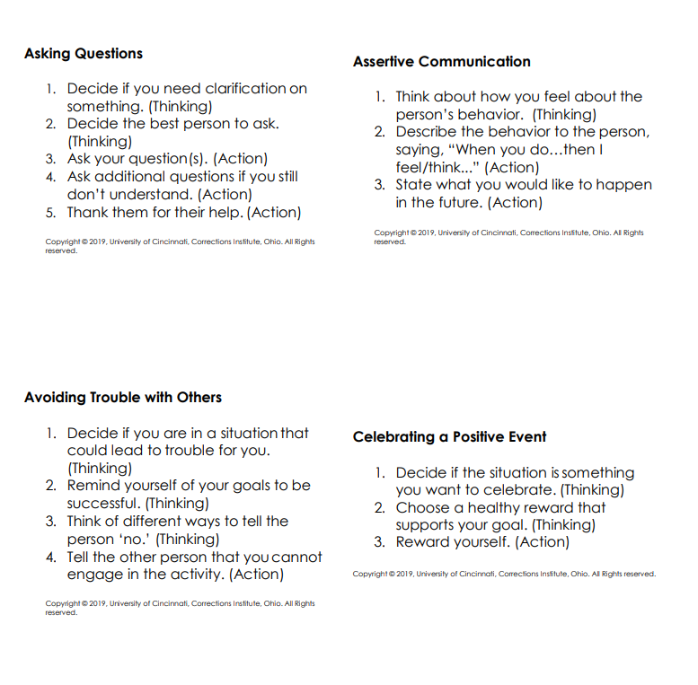

Slide 43
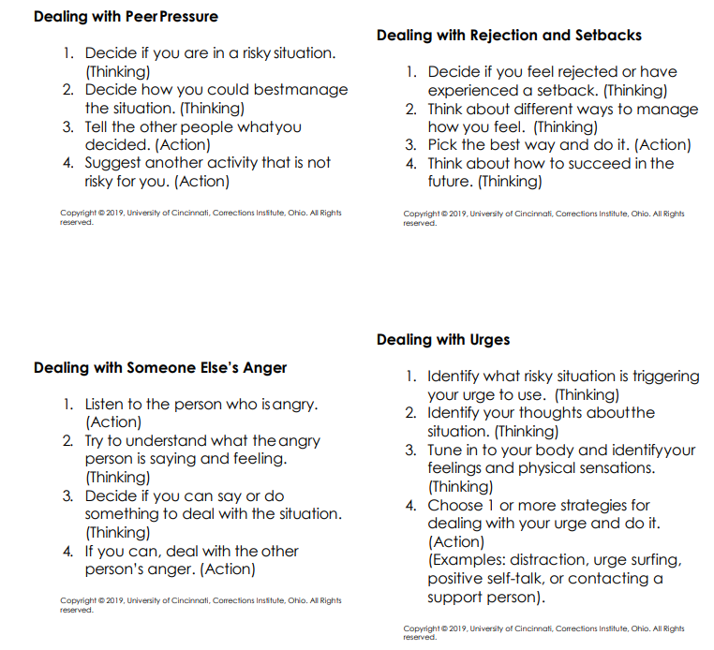

Slide 44
Role Playing and Recidivism
Recidivism Rates
0% recidivism with 3+ role plays/week
Sperber, K. G. & Lowenkamp, C. T. (2017). Dosage is more than just counting program hours: The importance of role-playing in treatment outcomes. Journal of Offender Rehabilitation, 57 (7): 433-451.
Notes:
Note that these are results from 1 study; however, the results are in line with meta-analyses on the importance of behavioral practices
The differences observed across role-play exposure are only significant for the medium risk offenders that received 100-199 hours of treatment.
**Note: the recidivism rate was 0 for 100-199 with 3+ role plays. The 0% recidivism rate doesn’t show up on the chart.
While tailoring Tx hours to the individual is important, it is not just “how much,” but also “what kind.” This study examined how dosage interacts with the use of role plays to influence outcomes
Moderate: Largest reductions with 100-199 hours of Tx and: (shown on slide)
<1 roleplays/week: 47% recidivate
1 roleplay/week: 31% recidivate
2 roleplays/week: 23% recidivate
3 or more/week: 0% recidivate
Low-medium: Largest reductions in recidivism with 100-199 hours of Tx and: (not shown)
<1 roleplay/week: 23% recidivate
1 roleplay/week: 13% recidivate
2 roleplays/week: 7% recidivate

Slide 45
Role Playing and Recidivism
Recidivism Rates
17% recidivism with 3+ role plays/week
Notes:
No offenders in the high risk group received 0-99 hours of treatment with 2 or more role-plays per week.
High: Largest reductions with 200 or more hours of Tx and:
<1 roleplays/week: 64% recidivate
1 roleplay/week: 54% recidivate
2 roleplays/week: 50% recidivate
3 or more/week: 17% recidivate

Slide 46
Structured Skill Building
Effective with adults and youth
Used to manage and avoid risky situations
  Can target risks related to any criminogenic need
Can be used in
  Community and residential settings
  One-on-one meetings and group settings
  Unplanned

Slide 47
Learning New Skills
3. Become proficient at the skill
2. Know what to do and how to do it
1. Have some motivation to learn the skill
Notes:
We sometimes assume persons engage in inappropriate behavior simply because they want to—everything is attributed to motivation. But persons also likely have skill deficits meaning they may want to change a behavior, but don’t have the skills for doing so. Ask if they have ever heard a client say “I knew it was wrong when I did it” or “I knew I would regret it, but I didn’t know what else to do”?
Think of a behavior you have been unsuccessful in changing (either now or previously). Why was it so difficult to change the behavior—because of motivation, lack of skills in combating triggers, or both?
To be best prepared to learn a new skill, it helps for the person to be motivated—this does not mean completely motivated—but it helps to get them to a place where they acknowledge some benefit to learning the skill. Sometimes just practicing a skill and feeling more comfortable with it will increase motivation.
To learn a skill, a person must also be taught what to do and when to do it, meaning what are the steps to performing the skill.
Finally, to get proficient at the skill, they must have the opportunity for practice of the skill.

Slide 48
Structured Learning: Skill Building
2. Model the skill
1. Define the skill
3. Practice the skill
6. Provide feedback
4. Provide feedback
5. Graduated practice
Image by Clker-Free-Vector-Images from Pixabay
Notes:
Once someone has motivation to learn a skill, we move into the detailed steps of teaching them that skill.
All skills involve steps. Teaching skills involves breaking down the steps and teaching them in a structured way.
Some steps involve thinking (label TH), while others involve action (label A)
Persons tend to struggle with the thinking steps and we want to intentionally practice them

Slide 49
Skill Building
1. Define the skill
Introduce and sell the skill
Review each step for understanding
Define “Thinking” and “Action” steps
Image by Clker-Free-Vector-Images from Pixabay
Notes:
To teach a skill we first introduce it and help the person see value in using the skill. This is typically done in the context of a specific situation. More specifically, a person comes to you with a problem and you identify a skill that will be helpful for them.
To teach the skill we show how it is broken down into steps. We go through each step and help them see why it is important and how they would do it in the current situation. We help them understand that some steps are thinking and some are action. We can explain how to perform the thinking steps when practicing by pointing to the temple with two fingers or holding their chin.

Slide 50
Skill Building
2. Model the skill
Prepare a scenario to demonstrate the skill
Ensure each step is easy to observe
Identify thinking steps as you model
Deliver your model
Answer follow up questions
Image by Clker-Free-Vector-Images from Pixabay
Notes:
We model the use of the skill making sure we achieve each step.
Modeling means showing the person how to walk through the steps of the skill.
It is helpful in 1:1 teaching to model using the steps as the person just described them. Ask them if they saw the steps played out.

Slide 51
Skill Building
3. Practice the skill
Individual identifies scenario for role play
Review plans for each step and provide feedback if needed
Individual engages in role play
Image by Clker-Free-Vector-Images from Pixabay
Notes:
Next is supporting the person as they practice the skill. This involves having them role play – it’s basically repeating what you just showed them. You will play the other person in the situation.
Before the role play, make sure to review what the person will do for each step so they have confidence and the role play goes smoothly.

Slide 52
Skill Building
4. Provide feedback
Individual gives self-assessment
If group setting – allow participants to provide feedback before facilitator
Provide specific strengths and areas of improvement
Image by Clker-Free-Vector-Images from Pixabay
Notes:
Give them feedback about how they performed the steps and praise their practice of the skill. Provide any needed coaching to help them be more successful at reducing risk. You may want them to practice the whole skill again if you gave substantive corrective feedback.

Slide 53
Skill Building
5. Graduated practice
Generalize skill to other situation
Options:
  Practice “in the moment”
  Use role play with more difficult situation
  Use role play with more realistic response
Image by Clker-Free-Vector-Images from Pixabay
Notes:
Ask if they could see applying this skill to the situation described or a similar situation. Get a clear description of when they could use the skill. Assign the skill for practice work in their day to day life.
As they begin making progress on using a skill, increase the challenge. Make the first time learning easy. Do not pressure them or be a difficult role play partner. As they get better with the skill you can add some pressure.

Slide 54
Skill Building
6. Provide feedback
If group setting – allow participants to provide feedback before facilitator
Individual gives self-assessment
Provide specific strengths and areas of improvement
Image by Clker-Free-Vector-Images from Pixabay

Slide 55

Structured Learning: Skill Building
Adult: Charles & Mindy Youth: Tim & Lori
Notes:
IF YOU HAVE INTERNET ACCESS CLICK ON THE COLORED NAME AND IT WILL LINK YOU TO THE VIDEO.
Pages 28-29 in the workbook.
Note: Mindy and Charles create their own steps to avoiding trouble with his peer. There are preset skills that are more convenient to use.
Adult: Charles & Mindy 12:47
http://youtu.be/ztJBaF3qbyk
Youth: Tim & Lori 11:58
http://youtu.be/oi5JvU074Tw
Now we’re going to watch a model or video demonstration of Structured Skill Building.
Please turn to pages 40 – 41 of the workbook, and follow along, making sure to identify all 6 steps were followed.
Note to trainer: consider assign different questions to trainees and debrief after the video.
You may use the review questions in a variety of ways . . .
Do them as one large group – read the question and have persons respond.
Have them answer all the questions in small groups or pairs and have a large group discussion of the questions.
Assign specific questions to groups and have them report out on their question.
Have the small groups answer all the questions and have them report out on one question each.
Save all the review activities until the end of the training and have small groups each take one and complete it and report out.

Slide 56
Structured Learning:
2. Model the skill
1. Define the skill
3. Practice the skill
6. Provide feedback
4. Provide feedback
5. Graduated practice
Image by Clker-Free-Vector-Images from Pixabay
Notes:
We use the same process when teaching cognitive restructuring. Recall how we taught the behavior chain.

Slide 57
Review Objectives
Briefly review the principles of effective intervention
Define structured learning
Review examples of how structured learning can be applied to specific skills
Notes:
This training compares effective programs (those most likely to reduce program person recidivism) to ineffective ones (those which either do not change program person behavior or those which may even increase the program person’s likelihood of committing new offenses).
It also explores the strategies or best practices to effect change in those we work with. These principles are known as the Principles of Effective Intervention.
Finally, we explore ways to work with correctional persons to reduce their risk of reoffending. All staff play a role in reducing risk and the research shows that we are most effective when we all operate out of a set of Core Correctional Practice. We will be learning 8 skills and will practice using them during the course of the training. We will conclude by discussing how to use the skills in our day to day interactions with individuals.

Slide 58
Summary and Questions
Notes:
Summarize the steps to problem solving and how it can be applied in the units or individually.

Slide 59

QUESTIONS?
Photo by Kelly Sikkema on Unsplash
Notes:
Ask for any questions from the entire 2 days. If administrative staff are present arrange in advance for them to speak to the participants on the next steps for implementation include.

Slide 60

www.uc.edu/corrections
Corrections.Institute@uc.edu damatocj@ucmail.uc.edu
Notes:
In your workbook you will notice there are additional worksheets.
These include:
8 CCP cards available as a cheat sheet
The social skills worksheet
The feeling faces
The UCCI tools
These can be copied and used as often as you need to best incorporate the CCPs into your daily work with persons.

