Slide 2
Community Corrections and Task Force Partnerships: Ohio’s Collaboration to Reduce Violent Crime Steve Vukmer, Regional Administrator - Cleveland Tyshawn Irby, Task Force Supervisor – Cleveland
Eric Persing, Parole Officer / Task Force Officer - Cincinnati Ohio Adult Parole Authority

Slide 3
Ohio Department of Rehabilitation and Correction Adult Parole Authority Supervises offenders on Parole, Post-Release Control, Community Control, and Interstate Compact. Statewide supervisee population: 22,877 Parole Officers / Senior Parole Officers: 644 Specialized caseloads or assignment include: *Mental Health *Sex Offender *Targeted Violent Offender *Task Force Officers
3

Slide 4
Partnerships with Federal Task Forces
History:
*Adult Parole Authority would issue a warrant for violators, but nobody actively searched for them. *Offenders would be VAL for years or arrested for new offenses of violence.
*In 1995 the Ohio APA began a pilot project in Cleveland to implement a “Fugitive Unit” to investigate, locate, and apprehend Parole Violators.
*Developed a partnership with the FBI Fugitive Task Force, as many Parole Violators were wanted for new violent crimes of murder, rape, and aggravated robbery.
*1997 assigned the first Parole Officer to the FBI Fugitive Task Force
4

Slide 5
History continued:
*FBI’s role transitioned after 9/11 to more terrorism investigations and homeland security
*US Marshal’s started Northern Ohio Violent Fugitive Task Force (NOVFTF) and the
Southern Ohio Fugitive Apprehension Strike Team (SOFAST) in 2003
*2003 APA assigned multiple officers to the USMS Task Force operations statewide
*2003 assigned officers to the new FBI Violent Crimes Task Force
*2016 assigned officers to the ATF Gun Violence Task Force
*2018 assigned officers to the DEA Drug Task Force
5

Slide 6
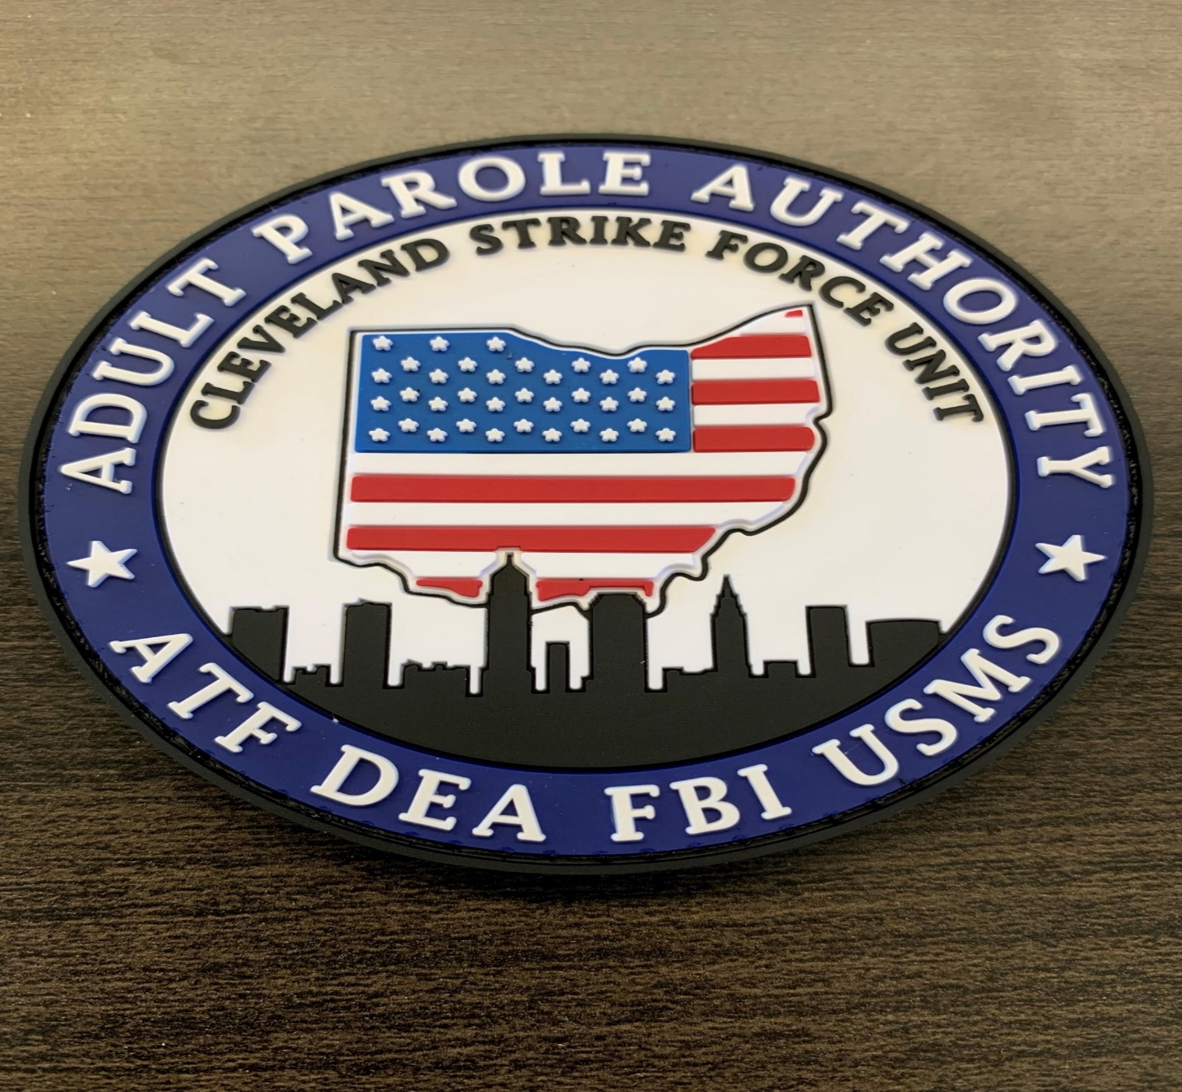
APA Task Force Operations
Local Task Force Operations: 11
State Task Force Operations: 1
Federal Task Force Operations: 4
Parole Officers assigned:
Full-time: 36
Part-time: 69
Total: 105

Slide 7
Bureau of Alcohol, Tobacco, Firearms and Explosives (ATF)

Slide 8
Violent Gun Crime Task Force
Investigate firearms trafficking, firearm related violent crime, gather & report intelligence data relating to violent crime involving firearms in conjunction with our local, state and federal partners
Conducts undercover operations where appropriate and engage in other traditional methods of investigation in order that the Task Force’s activities will result in effective prosecution before state and federal courts

Slide 9
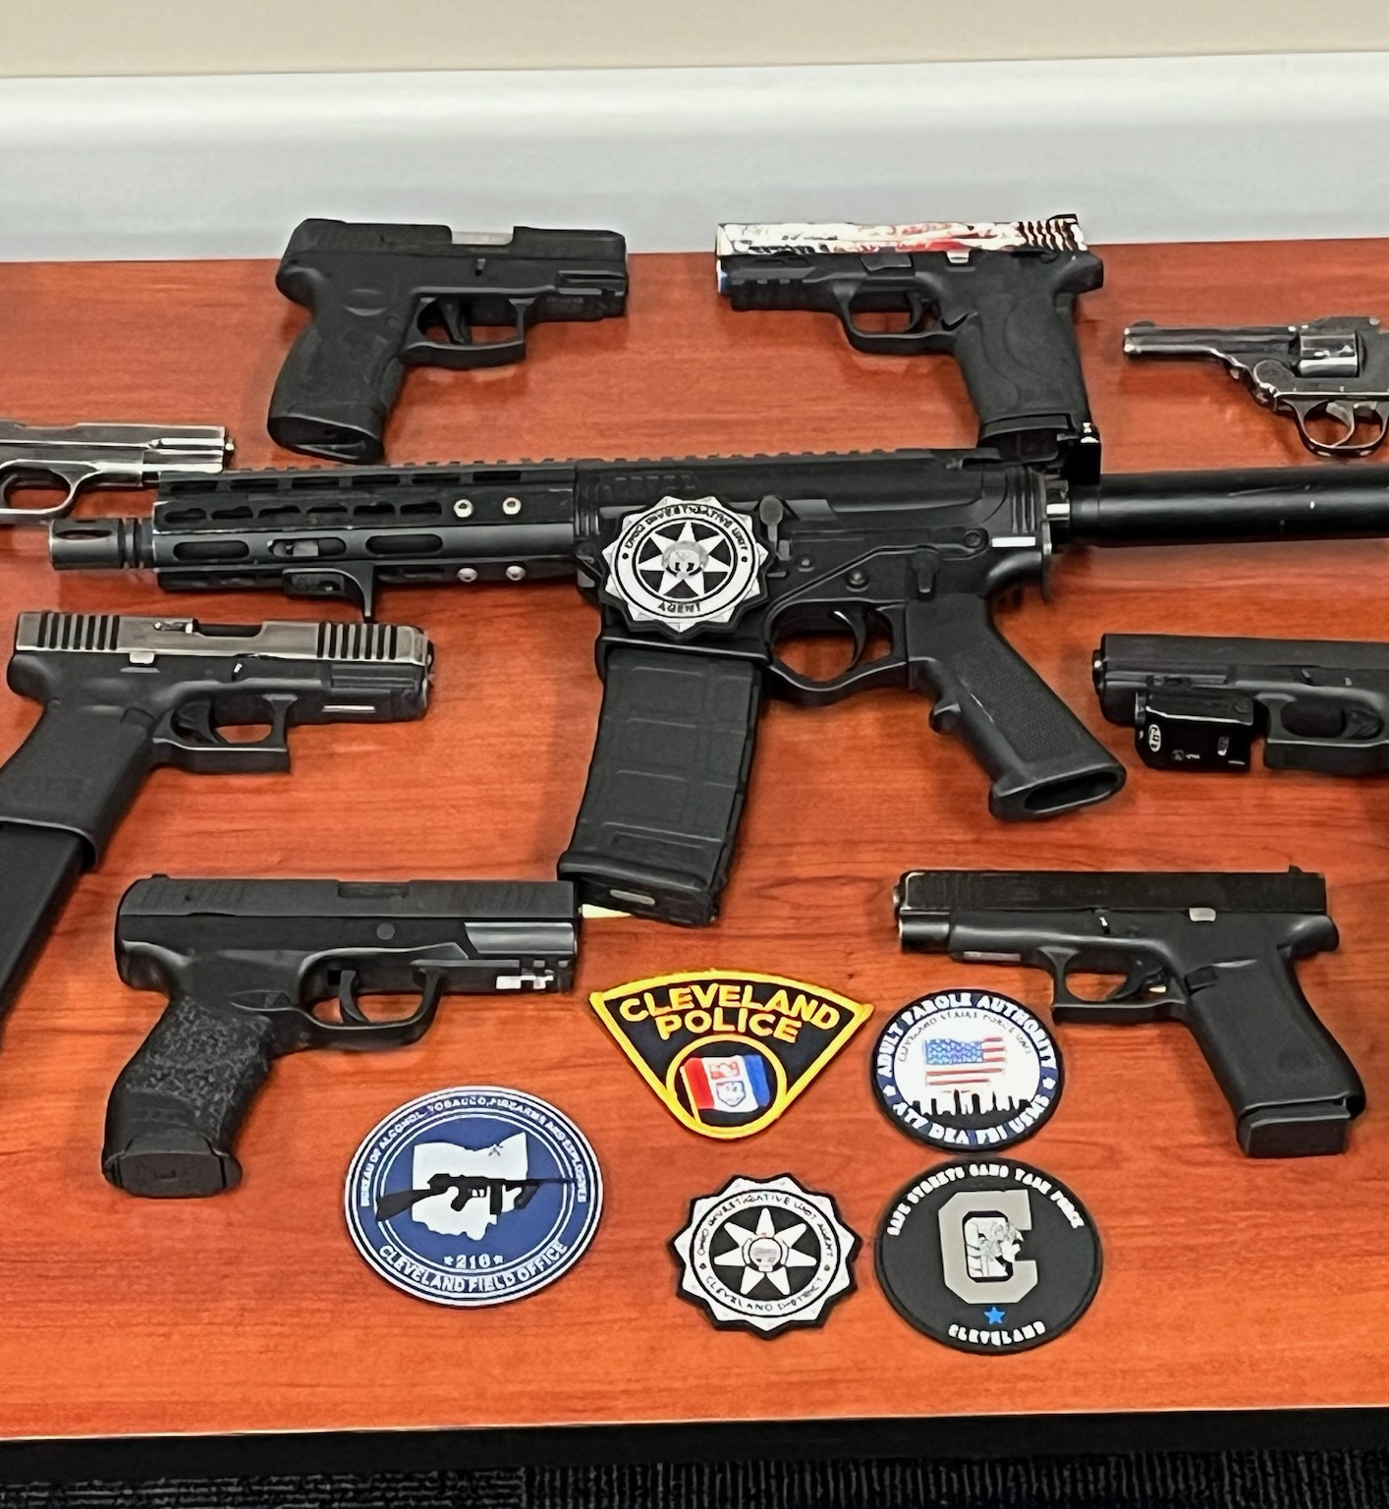
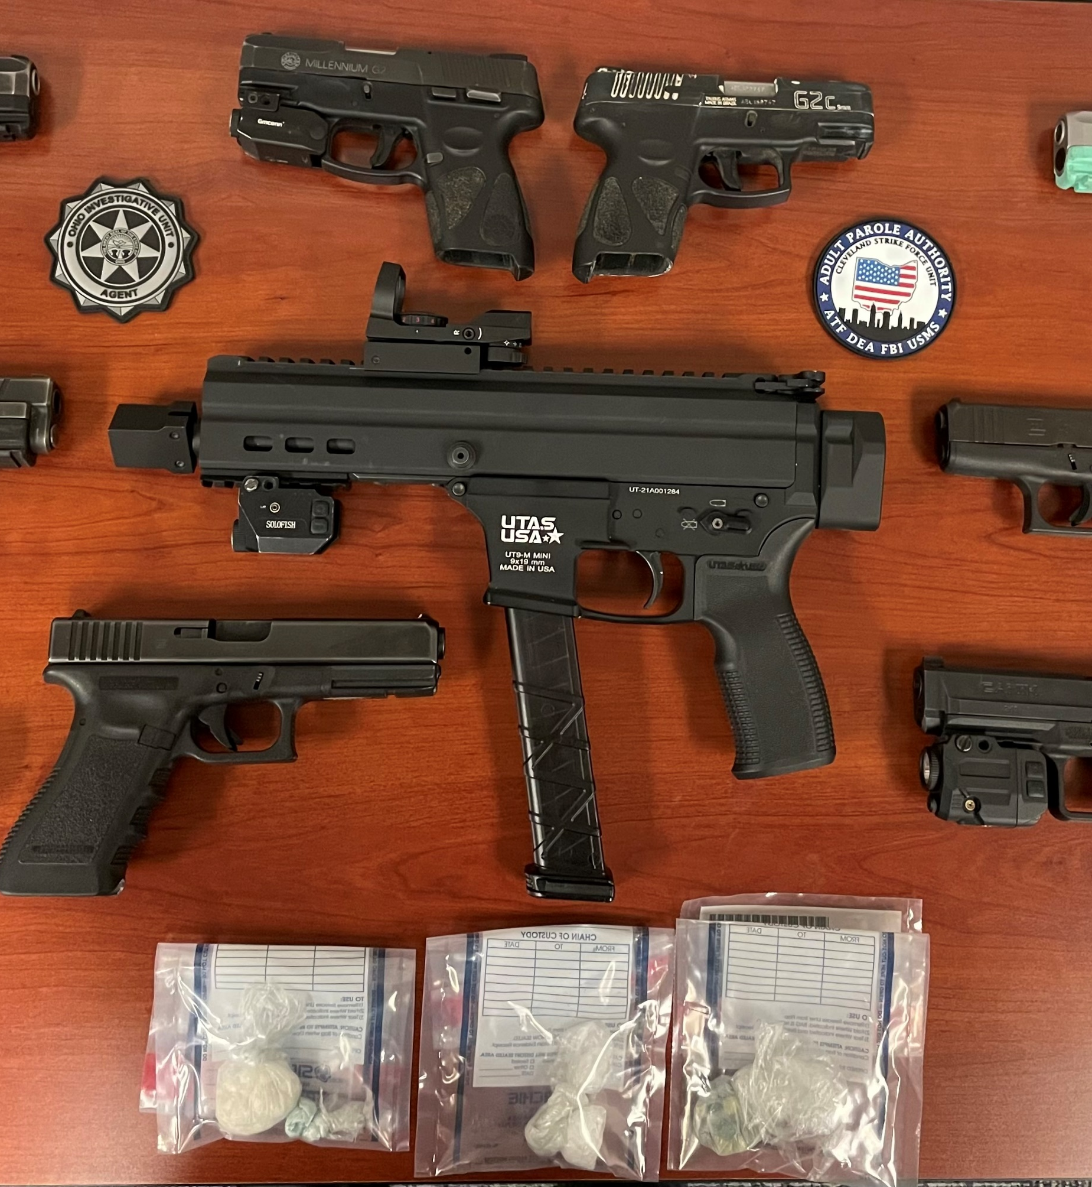

Slide 10
Local PD/APA/USMS arrest an offender with firearm(s)/ammunition
Case is sent to TFO for review
TFO completes criminal history probable cause statements, begin initial invest, open investigation into how firearm was acquired/used
Task Force Officer determines eligibility
If offender is a good candidate for federal prosecution, his case is sent to the United States Attorney’s Office for federal prosecution
If offender is not a good candidate for federal prosecution, the case will remain with the State of Ohio
Task Force Officer’s Investigation
Completes Reports of Investigation (ROIs) and present them to the USAO / ATF
Conducts interviews, investigates the firearm, submits the firearm for NIBIN submission to determine if the firearm was used in other crimes

Slide 11
Common ATF Charges for PRC Offenders
Title 18, United States Code (USC) Section 924 (c)
Using or possessing a firearm during the course of a drug trafficking or another violent crime.
This charge carries very significant potential penalties that must run consecutive to any other sentences
Title 18, USC Sections 924(a)(1) and (2) – Straw Purchasing of Firearms
Making a false statement on ATF Form 4473 → form warms applicant that they must be the actual buyer of the weapon
Allows investigators to charge the buyers of weapons
Title 18, USC Section 922(g) – Felon in Possession of a Firearm/Ammunition
Makes it unlawful for certain classes of individuals to ship, transport, possess or receive any firearm or ammunition with the required interstate commence nexus
Loosely equivalent to state charge of “Having Weapons While Under Disability”

Slide 12
Drug Enforcement Administration

Slide 13
DEA
Mission/Duties: To disrupt and dismantle illicit drug trafficking in Ohio by immobilizing targeted violators and trafficking organizations; gather and report intelligence data relating to trafficking in narcotics and dangerous drugs; and conduct UC operations where appropriate and engage in other traditional methods of investigation in order that the Task Force’s activities will result in effective prosecution before of courts of the United States and the State of Ohio

Slide 14
DEA – Task Force
Conduct drug and money laundering investigations with the goal of successful federal prosecution
Investigations can include the following type of operations: Surveillance, Buy Walk, Buy Bust, T-III Wiretaps, Reverses, Flash, Interdiction, Search Warrants
Duties: Evidence processing, report writing, respond to tip line leads, court testimony, drafting affidavits, undercover roles, develop/maintain confidential sources (CSs)

Slide 15
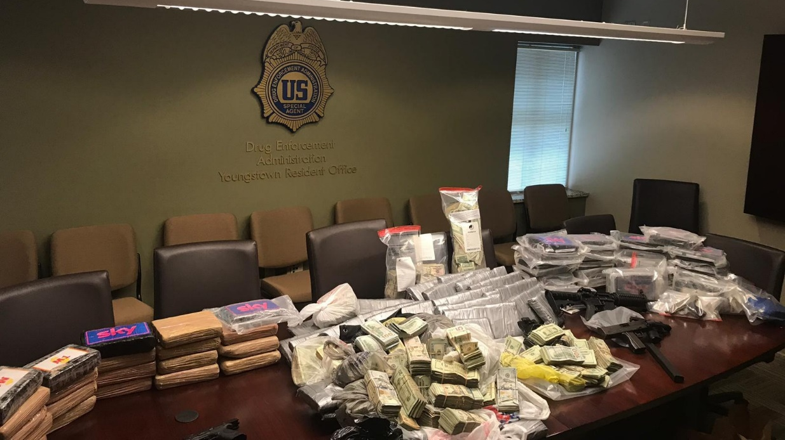
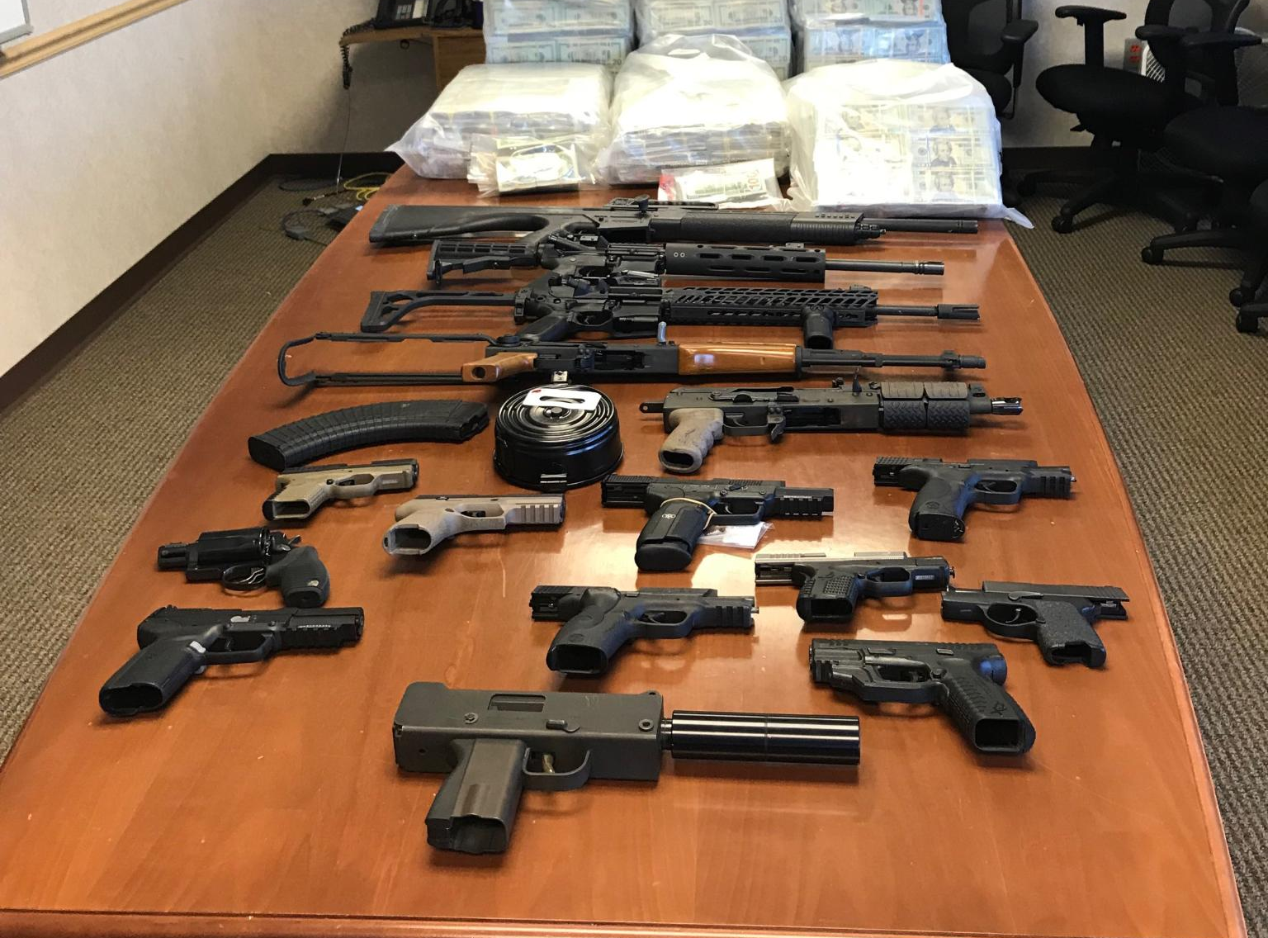
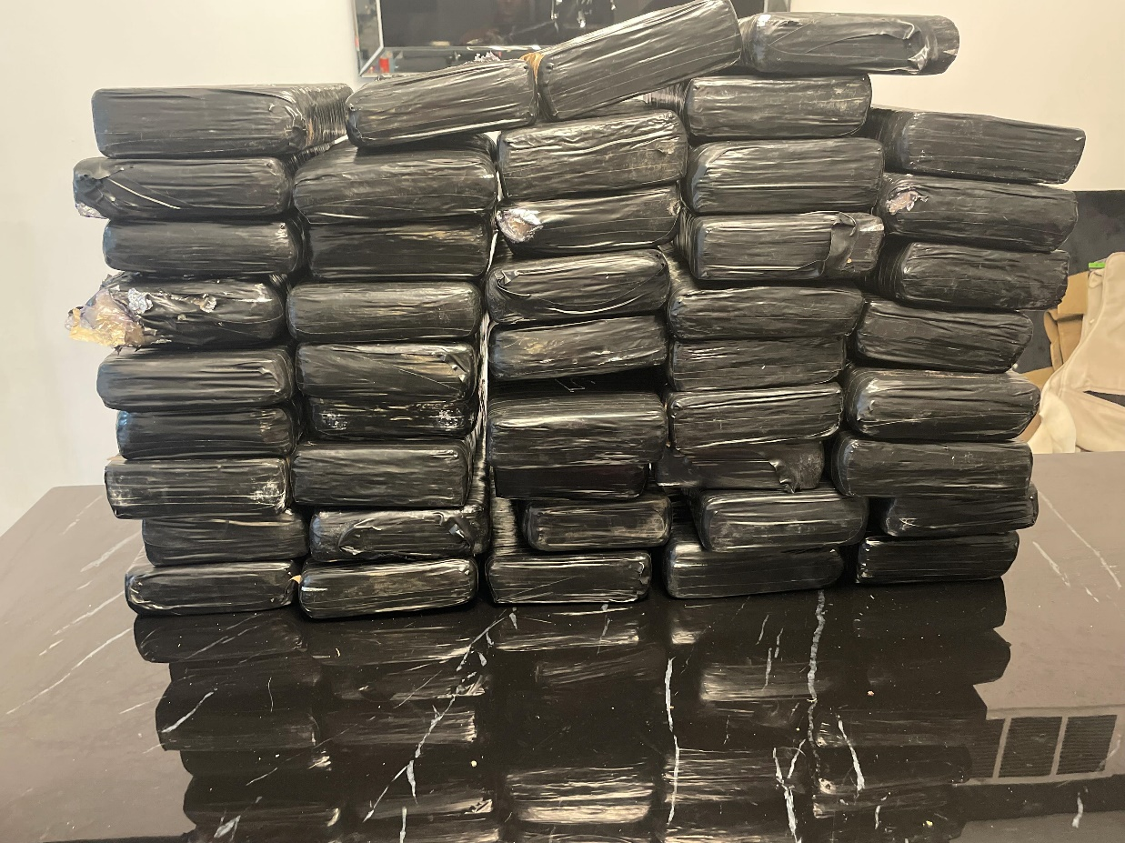
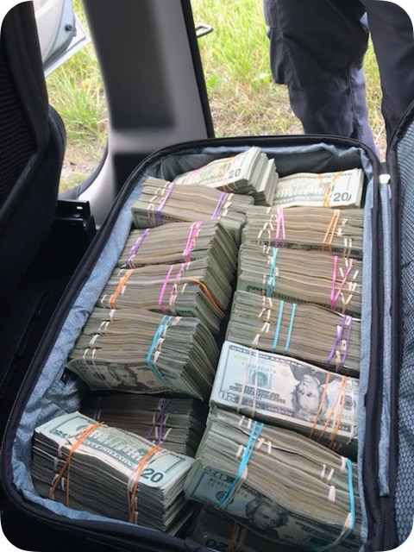

Slide 16
Federal Bureau of Investigation (FBI)
The FBI concentrates on crime problems that pose major threats to American Society. Significant violent crime incidents stretch state and local law enforcement resources to their limits
APA has TFOs assigned to the following FBI Squads:
Safe Streets Gang Task Force
Cartel Gang Narcotics & Laundering Task Force
Violent Crime Task Force
*Child Exploitation Task Force

Slide 17
FBI Squad 11 – Violent Crimes Task Force
Child Exploitation
The illegal production, transportation, distribution, receipt, advertising and possession of child pornography, as defined in section 2256(8) of Title 18, USC, as well as the transfer of custody of children for the production of child pornography, is harmful to the physiological, emotional, and mental health of the children.
Human Trafficking
also known as trafficking in persons or modern-day slavery, is a crime that involves compelling or coercing a person to provide labor or services, or to engage in commercial sex acts. The coercion can be subtle or overt, physical or psychological. Exploitation of a minor for commercial sex is human trafficking, regardless of whether any form of force, fraud, or coercion was used.

Slide 18
FBI Squad 12 – CGNL
Cartel Gang Narcotics & Laundering Task Force (CGNL)
Formerly known as NOLETF (Northern Ohio Law Enforcement Task Force) and the Caribbean Drug Task Force
Investigate federal drug and money laundering crimes
Also includes Ohio HIDTA (High Intensity Drug Trafficking Area) HIT (Hotel Interdiction Team)
The task force is comprised of multiple federal agents in addition to local and state agencies

Slide 19
FBI Squad 16 – Safe Streets Gang Task Force
A collective effort of Federal, State and Local partners collaboratively addressing violent street gangs to pursue Federal Gang charges
Comprised of members of the Cleveland Police Department, Ohio Investigative Unit, Federal Bureau of Investigation and the Adult Parole Authority

Slide 20
Squad 16 Duties
Assist APA in fugitive apprehension of Parole Violators
Conduct Field/Home visits on high-risk gang members on PRC
Conduct interviews of offenders that are victims of gunshot wound (GSW)
Review Crime Strategies reports
Evidence processing
DRC 1000s
Testify in APA hearings and criminal proceedings for state and federal court
Work with both federal and state prosecutors on indictments of new Felon in Possession / Having Weapons While Under Disabilities charges

Slide 21
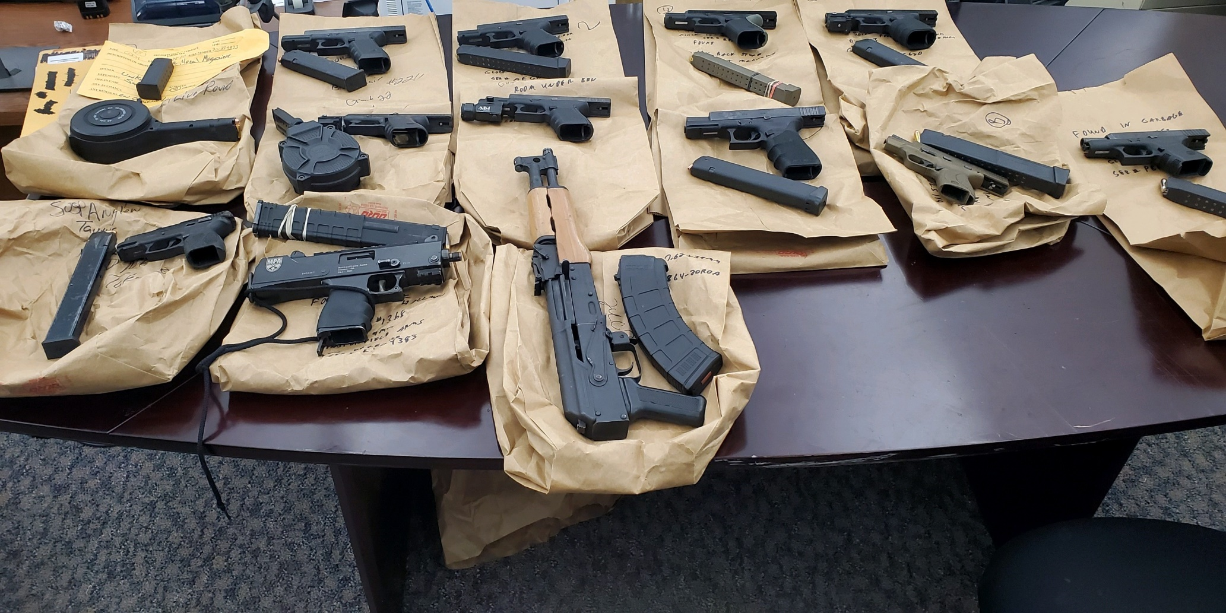
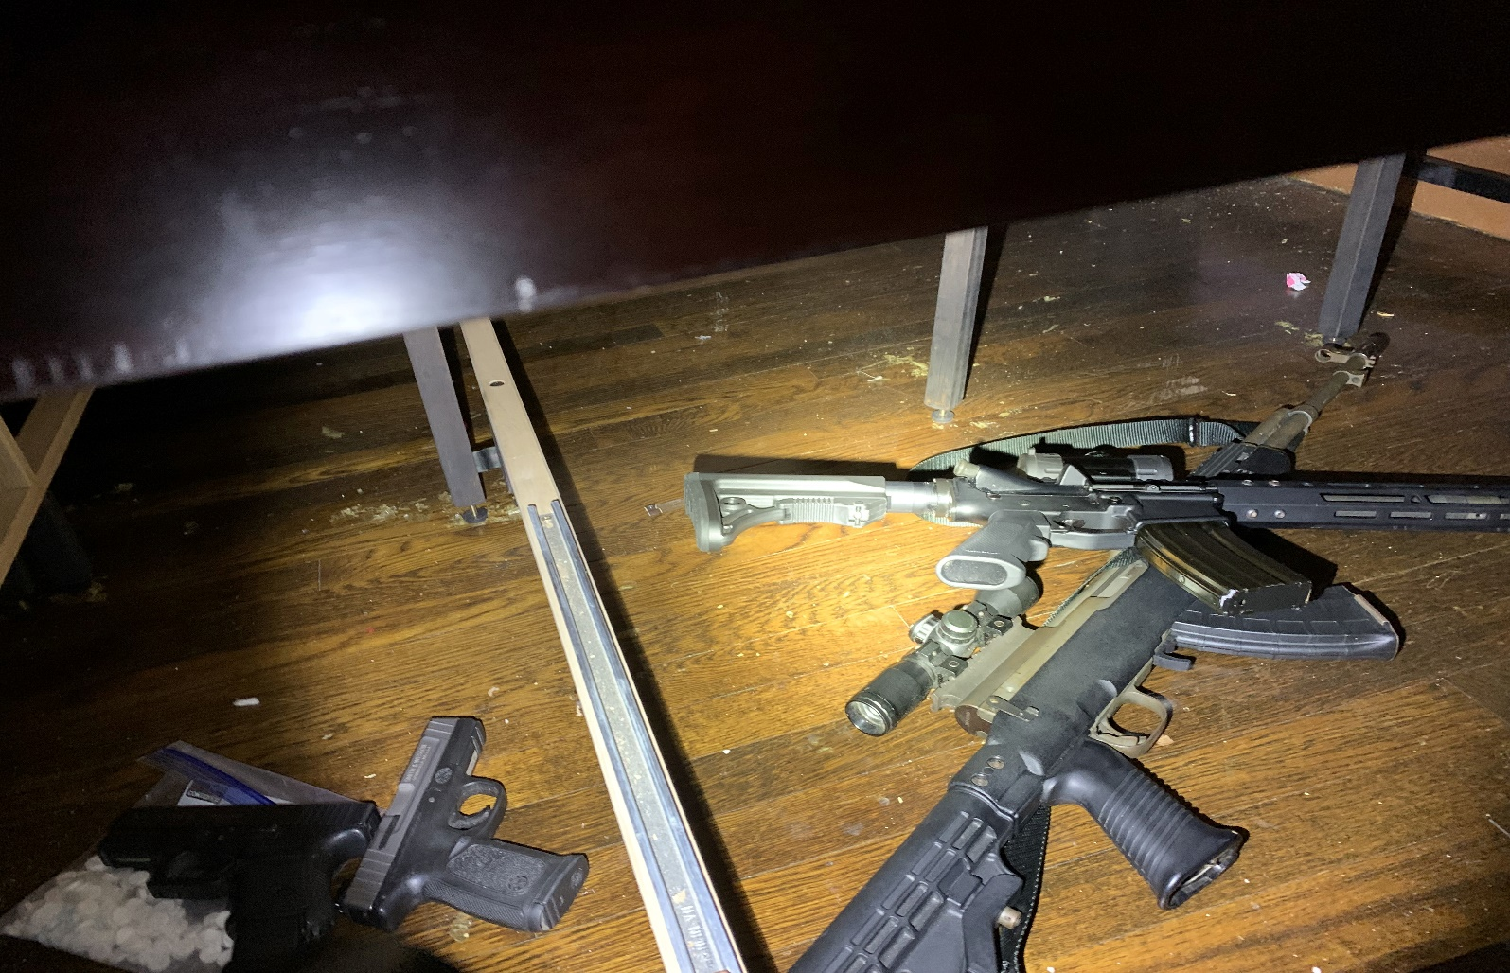
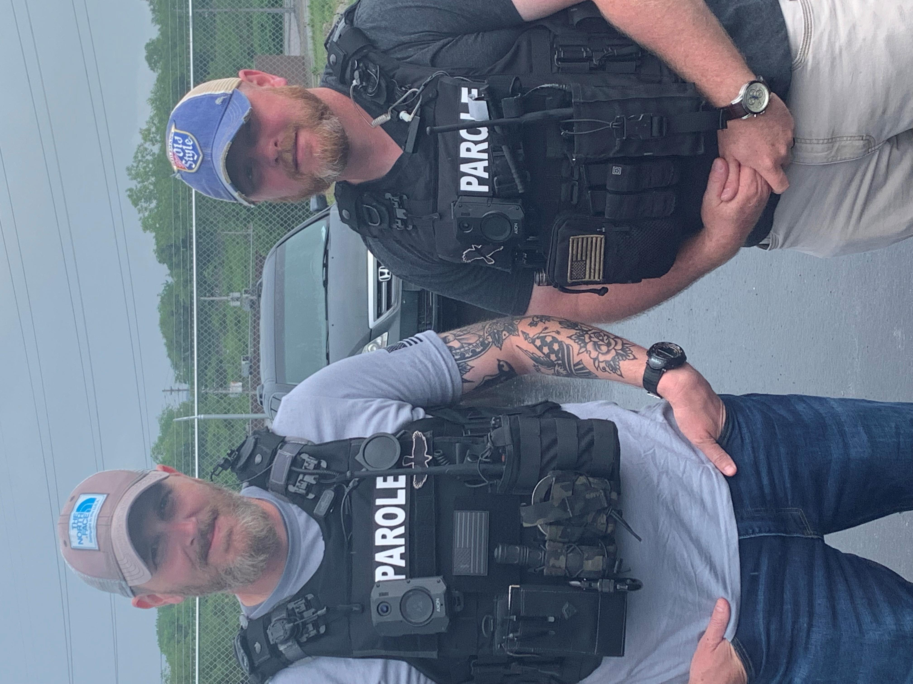
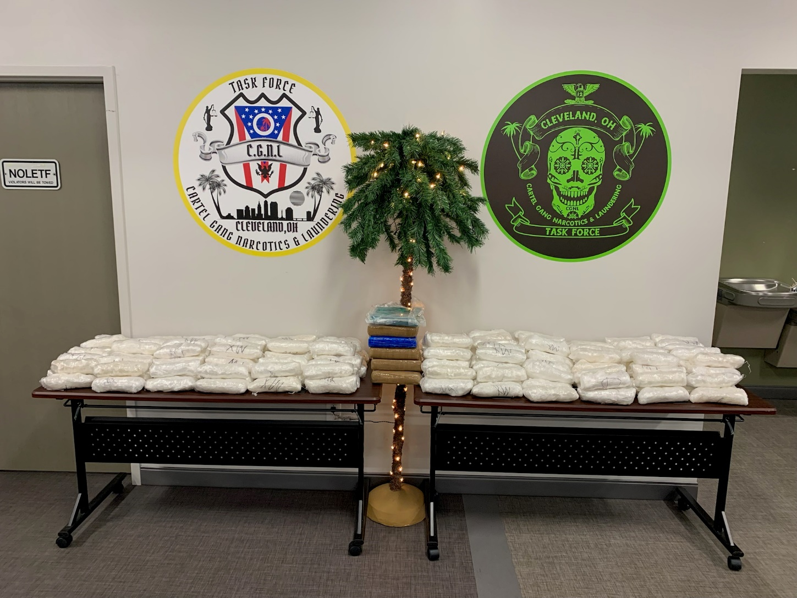

Slide 22
United States Marshals Service (USMS)

Slide 23
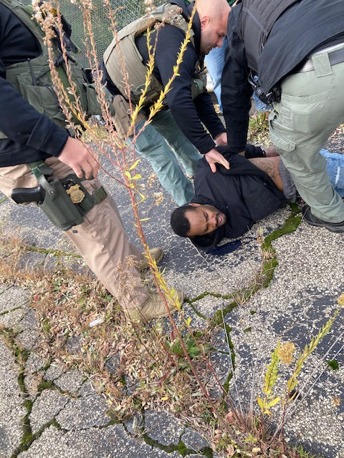
USMS
Mission: To enforce federal laws and provide support to virtually all elements of the federal justice system by providing for the security of federal court facilities and the safety of judges and other court personnel; apprehending criminals; exercising custody of federal prisoner transportation; asset forfeiture and witness security

Slide 24
Northern Ohio Violent Fugitive Task Force (NOVFTF) Southern Ohio Fugitive Apprehension Strike Team (SOFAST)
The USMS Task Force operations are a collaborative, statewide law enforcement effort spearheaded by the USMS that is dedicated to the pursuit, apprehension and successful prosecution of violent adult fugitives across Ohio with outstanding state and federal felony warrants

Slide 25
APA Task Force Duties
APA TFOs are deputized as Special Deputy U.S. Marshals who act as fugitive investigators who oversee the implementation, monitoring and clearing of warrants of Parole, Post Release Control, Transitional Control and Treatment Transfer offenders who have absconded supervision and have been alleged to have committed new (violent) offenses as well as inmates who escape from ODRC institutions. These offenders are referred to as Parole Violators at Large.

Slide 26
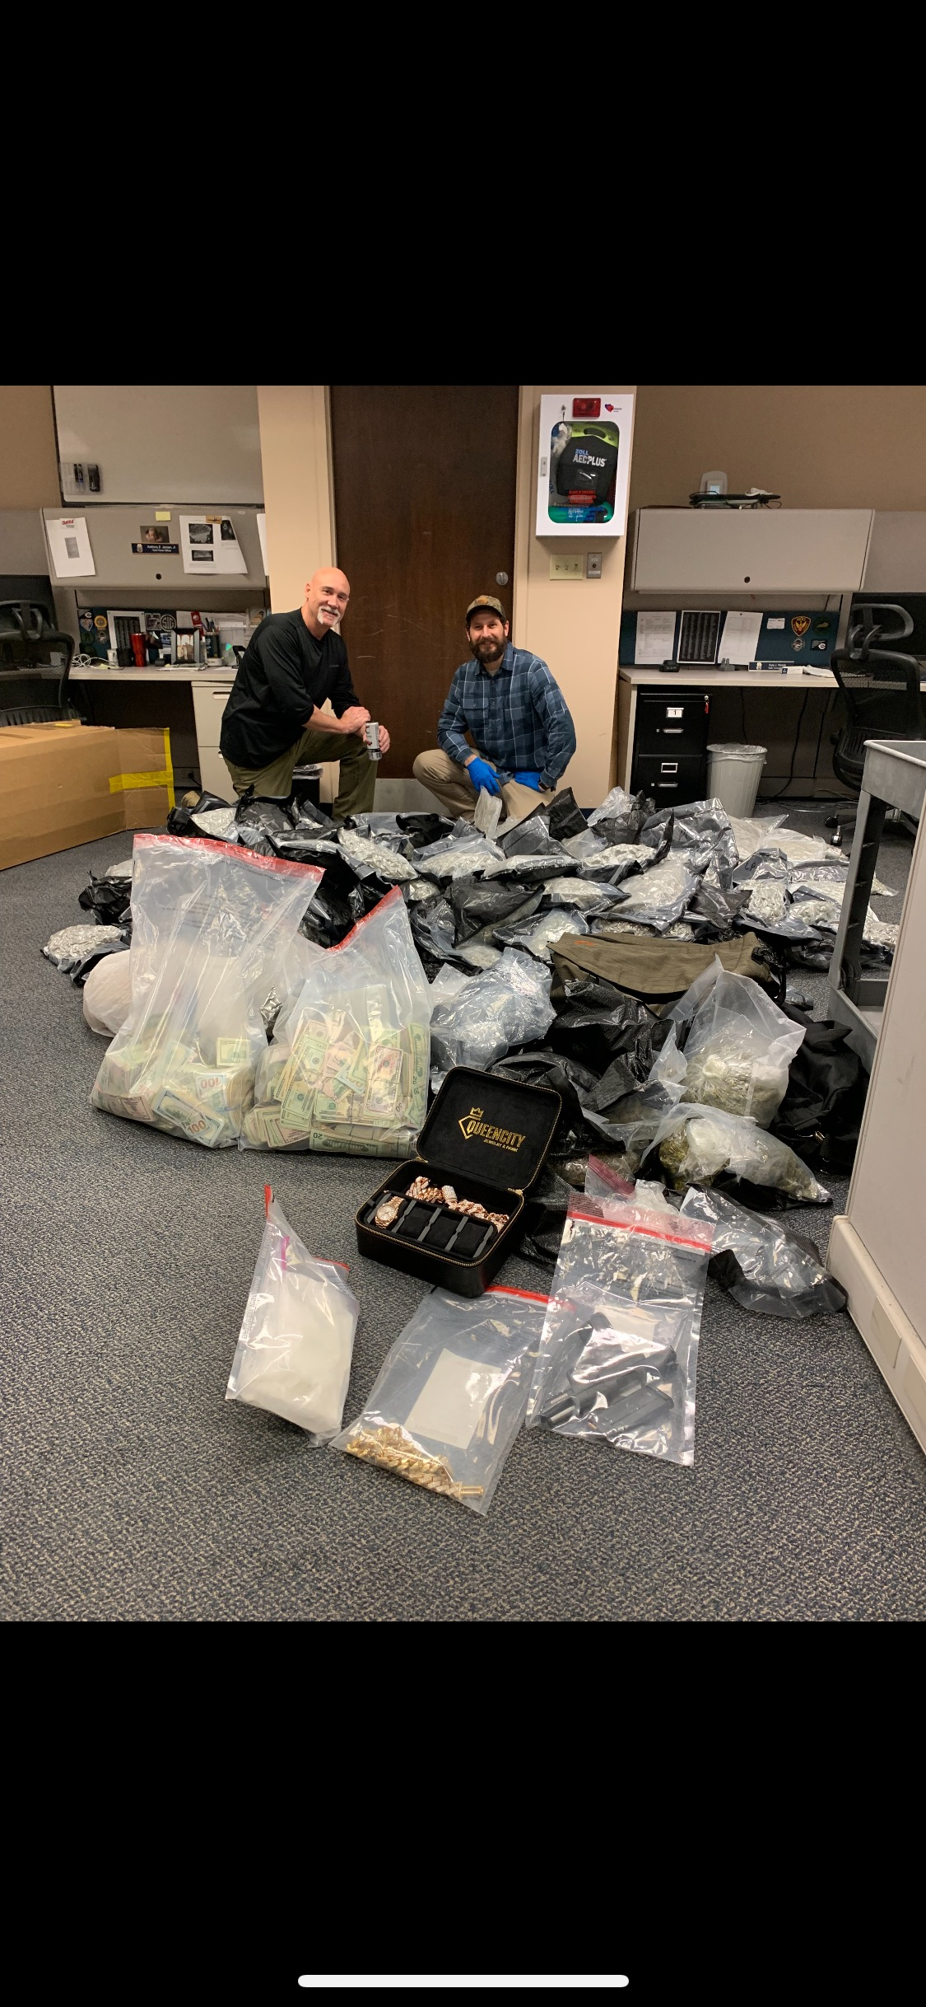
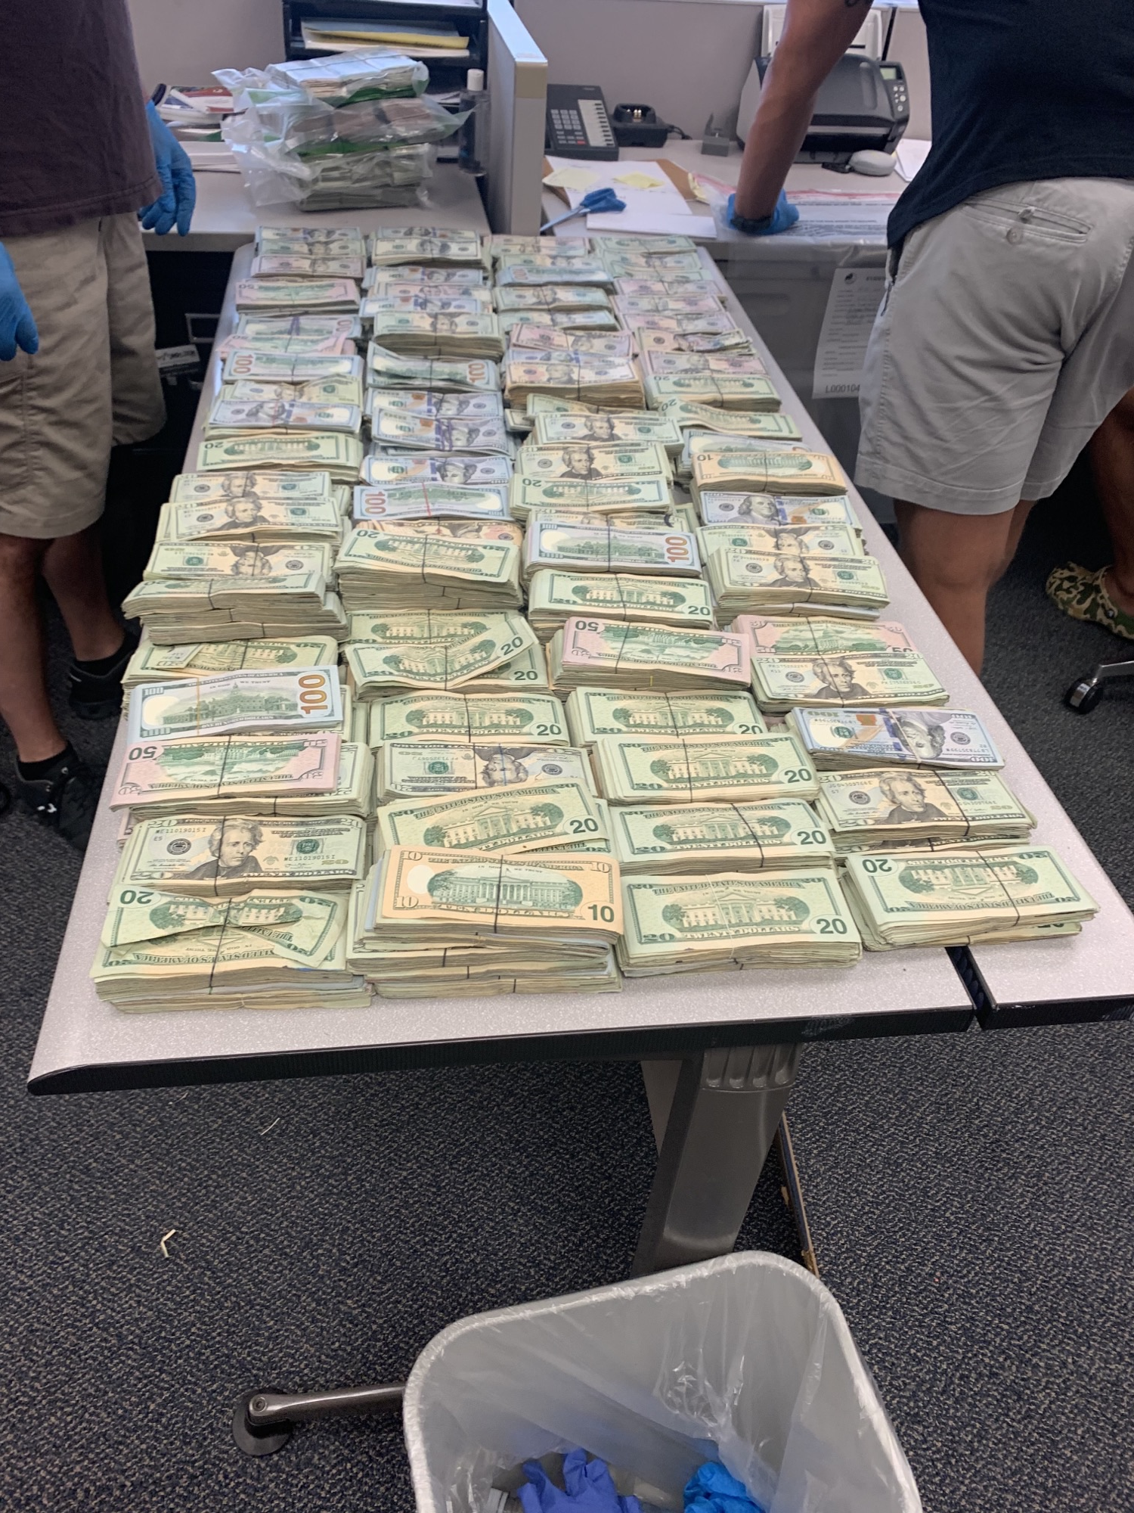
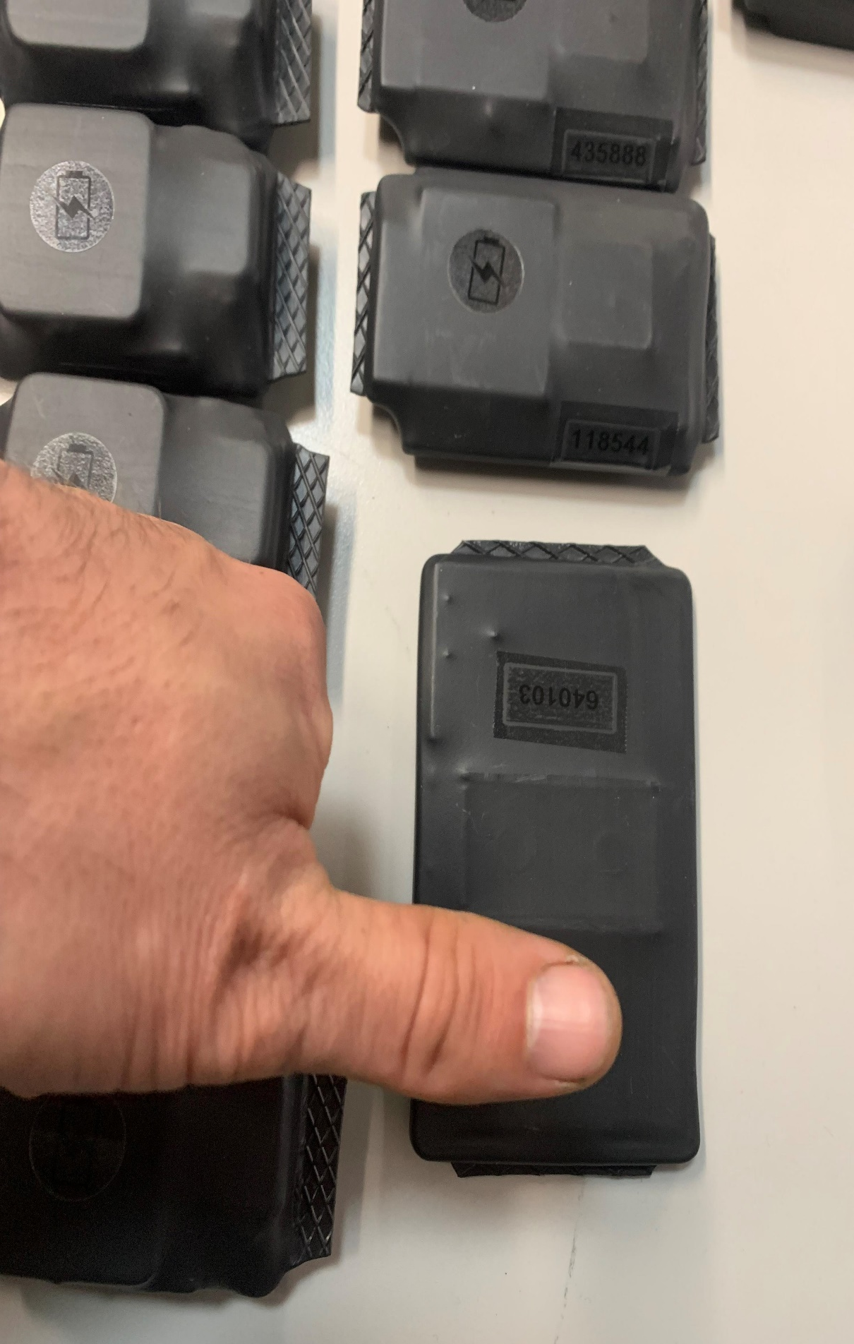
Task Force Officer: A day in the life

Slide 27
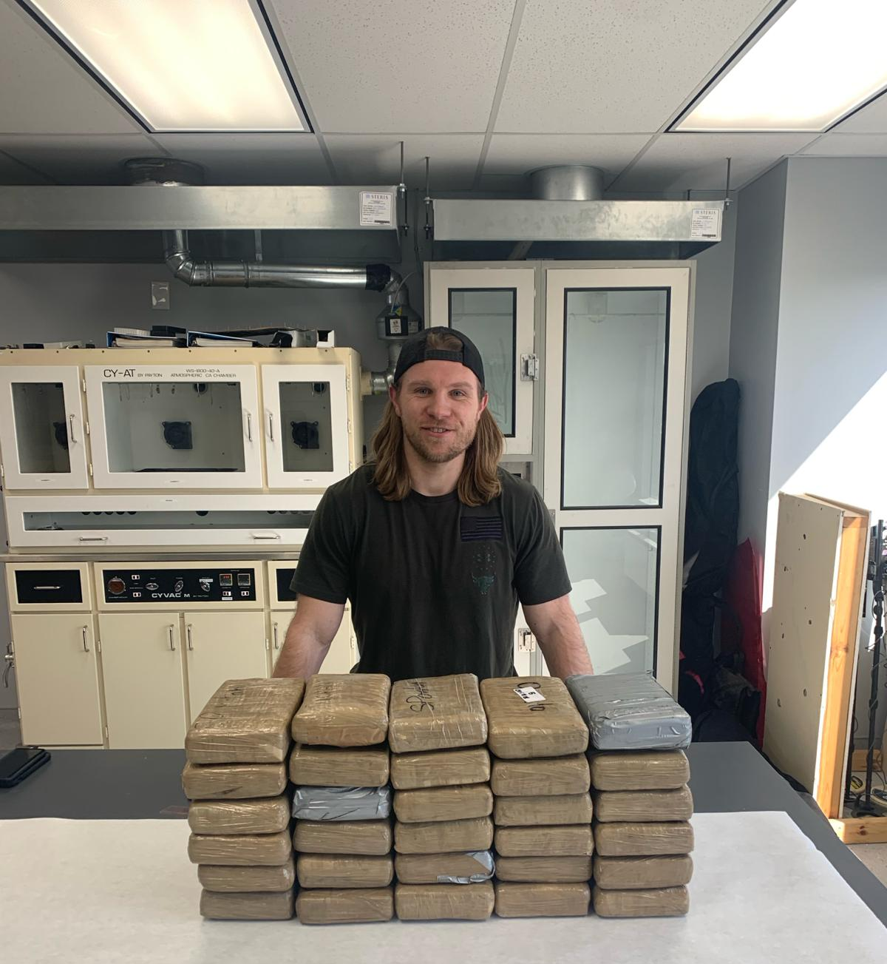
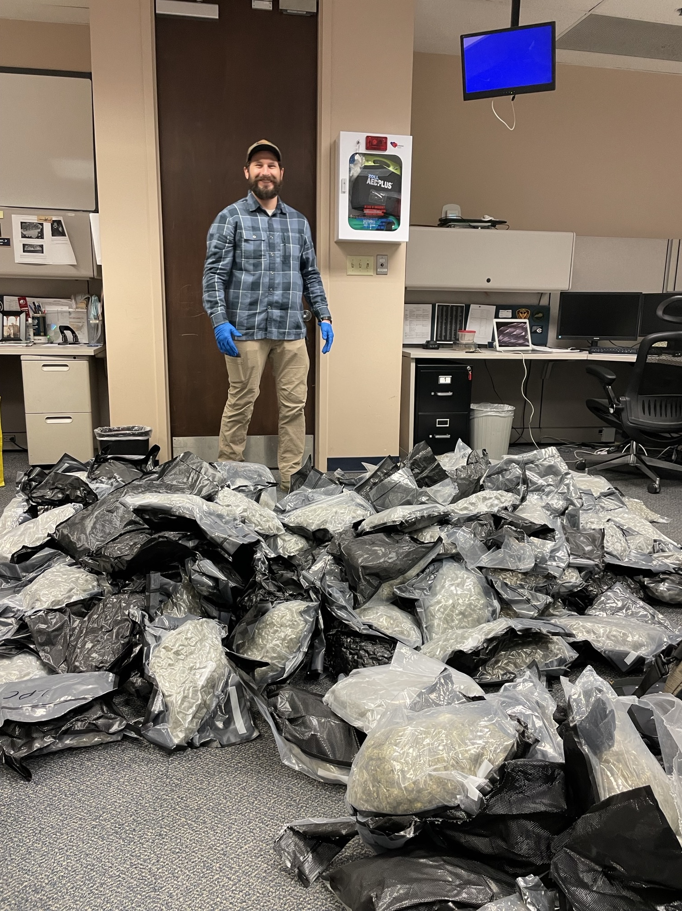

Slide 28
How does the APA help the Task Force?
Information sharing:
Offenders, families, friends, associates, phone numbers, addresses, cars
State resources:
Personnel, equipment, vehicles
Crime Scene Correlation (GPS/EM)
Authority:
Ability to search, arrest, and detain with “reasonable grounds”

Slide 29
What’s in it for us?
Collaborative partnerships with local, state, and federal law enforcement agencies
Immediate assistance when needed
Asset Forfeiture:
September 2017 to September 2024: $926,142
January 2024 to September 2024: $421,706

Slide 30
QUESTIONS?
DRC.OHIO.GOV

Slide 31
DRC.OHIO.GOV

