Slide 1
Using Plan, Do, Study, Act to Enhance EBP Implementation
LaVerne Williams, Amanda Howard, & Micheal Dent

Slide 2
How It Was

Slide 3
Background:
Higher client count
Client turned over faster
Higher caseworker case loads
Staffing Turnover after COVID-19
High Front-Line Staff turnover
New Administrator
New Coordinator
New Continuous Quality Improvement Specialist
3 New Caseworkers

Slide 4
EPICS II
What is EPICS
Effective Practices in a Correctional Setting II
Assessment Skills
Intervention Skills
Bridging Skills/Core Correctional Practices
Supplemental Skills
Problem Solving
Criminal Thinking Scale

Slide 5
Agency Expectations:
At least 70% of all caseworker meetings utilize a skill
Caseworkers submit audio recordings for Quality Assurance purposes
Audio Submission amount is based on proficiency level
11 different areas to receive a rating in
Ongoing training that is required based of proficiency level
Ongoing Coaching

Slide 6
PDSA
Plan
Do
Study
Act
Notes:
2 Minutes of asking questions

Slide 7
Problem Statement
In 2022 the RIPP facility experienced a 100% turnover in the following positions:
5 Caseworkers
Program Coordinator
Program Administrator
CQI Specialist
The My Utilized Skills (MUS) percentages which measures EPICS II skill utilization and audio submissions for Caseworkers had declined.
Teach-backs were not enough to promote skill development due to lack of individual training space (CWs share offices) and lack of available sessions in the skills that were needed.

Slide 8
Audio Submissions at the RIPP Facility from April 2022-December 2022

Slide 9
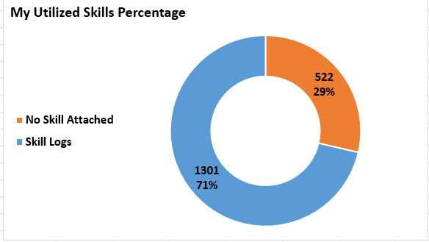
MUS % April-December 2022

Slide 10
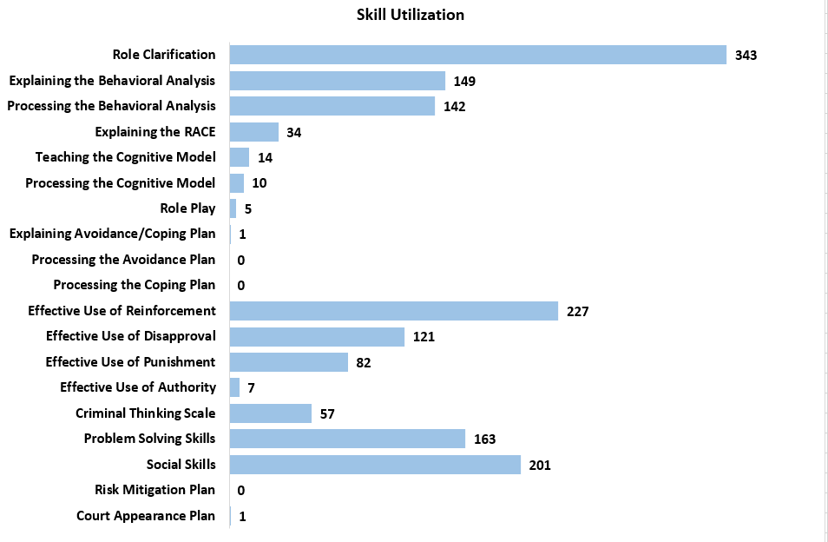
Skill Utilization April-December 2022

Slide 11
Goals
Provide support for the caseworkers to earn their EPICS II rating
Increase the MUS percentage
Increase CW comfort with EPICS II skills
Caseworker retention
Promote a partnership in which CQI and Facility Supervision were working in collaboration to promote an active learning environment.

Slide 12
Plan
Mapping meeting between PC Williams and CQI
Reviewed MUS % and Reviewed Audio Assignments/submissions
Weekly in house trainings 1 hour before BMC on Tuesdays.
Skill overview
Role Play (Modeling between Coordinator and CQI)
Role Play each staff in groups
Met with PA Micheal Dent
Discussed the plan that PC Williams and CQI decided upon
Looked at available Teachbacks
Realized that doing this in house weekly would be a way to train all caseworkers at a faster pace than what was being offered.
Made a schedule based on EPICS skills
Looked at how to best build a team approach to learning
Invited ‘guest’ instructors to participate

Slide 13
Do
PC Williams set a meeting between all of the Caseworkers and CQI on 12/13/2022.
During this meeting the goals were shared, expectations were set and questions were answered
Required attendance at weekly training sessions
Submission of required audios

Slide 14
Collaborative Weekly Trainings
Weekly trainings were held each Tuesday for One Hour. During this time we used the following training techniques:
Overview of the EPICS II Skill
Coordinator and CQI demonstrated the skill
Time for Questions and Answers
Divided the Case Workers into pairs to practice the skill
PC and CQI walked around giving feedback in real time
Demonstration giving by a selected group
Debriefing

Slide 15
Study
Increase in audio submissions:
October 2022- 2 total audio submissions
November 2022- 2 total audio submissions
December 2022- 14 total audio submissions (note during this time there were several audios that were not required due to time off for the caseworkers)
January 2023- 15 total audio submissions as of 01/23/2023 and an additional 8 audios submitted for caseworkers who were rated in a skill but wanted extra non graded feedback.
Increase in questions asked by caseworkers
January MUS will be examined in the beginning of February to look for increase in MUS percentage and overall skills.
Caseworkers are reporting feeling more comfortable using a variety of EPICS skills in case management meetings.

Slide 16
Audio Submissions January- April 2023

Slide 17
MUS % January-April 2023

Slide 18
Skill Utilization January-April 2023

Slide 19
Act
This training model was presented to all leadership staff for the agency.
Other CQI staff from all regions shadowed the process to replicate this in the facilities that they work in.
With turnover we are as in agency revaluating this and plan to complete another round of PDSA.
Since the PDSA is a cycle their can be multiple runs before a process has moved into a standard practice.

Slide 20
Activity
Mrs. Potato Head PDSA Activity, permission to use by David Williams

Slide 21
Directions
Each table elect 3 roles
Time keeper
Responsible for keeping time
Quality Assurance
Responsible for comparing the assembly to the standard
Assembler
Putting together the model

Slide 22
Group responsibilities to observe strengths and improvement areas and provide input into the plan.
These roles will remain the same throughout the activity

Slide 23
Baseline and Accuracy
Notes:
LaVerne establishes baseline.. Ask the questions.. How long do you think this will take you? What is your plan in putting it together?

Slide 24
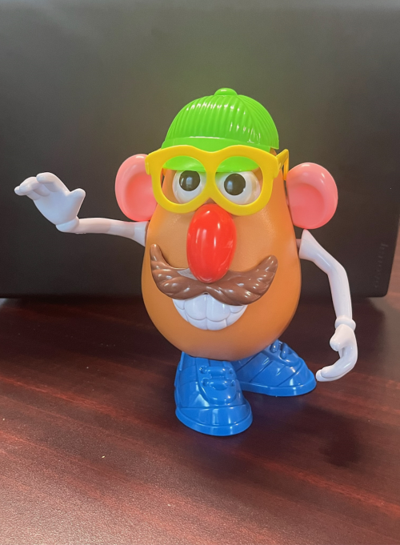

Slide 25
BEGIN

Slide 26
Debrief
How did it go?
What would you do differently?

Slide 27
Round 2

Slide 28
Debrief

Slide 29
Summary
Most implementation stops with the Do.
When implementing a new process it may take multiple cycles of the PDSA process in order to gain the desired result.

