Slide 1
Innovative Justice Solutions: Fostering Effective Partnerships and Programming in Correctional Settings
Dr. Kara Marciani
Teresa Russell
Judge Kate Huffman

Slide 2
Learning Objectives
Identify today’s jail population and the challenges created to traditional corrections
Understand the opportunity to harness the attention of the captive audience in a corrections setting in order to provide valuable services
Determine the impact of collaborative corrections-based services in supporting pre-trial, community supervision, specialized docket and re-entry efforts

Slide 3
The Traditional Purpose of Corrections

Slide 4
Expectations For Support From County Sheriffs and Criminal Justice Leaders
Jails have become a revolving door for individuals struggling with mental health and substance use disorders. More than 10 million individuals pass through jails around the country annually, with at least half of those individuals having substance use disorders, half of whom are opioid abusers. Individuals suffering with mental health and substance use disorders come in and out of the jail, with arrests, incarceration, and release to the community, where the abuse restarts and the cycle continues when they commit another crime. Without effective intervention, this drives our nation’s crime rate dramatically, while those who are most vulnerable remain sick. Jails not only oversee individuals struggling with substance use disorders and withdrawal, but are also in a unique position to initiate treatment in a controlled, safe environment.
National Sheriff’s Association (2018)

Slide 5
Today’s Corrections
Medical care
Detox
Screening and Assessment
Social services
Treatment
MAT

Slide 6
Some Data
65% of prison/jail population experience active SUD
Another 20% do not meet criteria for SUD but under the influence of drugs or alcohol at the time of the offense
Between 2000 and 2019, the number of local jail inmates who died from all causes increased 33%; the number who died from drug/alcohol intoxication increased 397%
Women die in jail at a rate almost double that of men
Those who died in jail of drug or alcohol intoxication were incarcerated a median of 1 day

Slide 7
Fact:
In 44 states, a jail or prison holds more mentally ill individuals than the largest remaining state psychiatric hospital; in every county in the U.S. with both a county jail and a county psychiatric facility, more seriously mentally ill individuals are incarcerated than hospitalized.
The Treatment of Persons with Mental Illness in Prisons and Jails: A State Survey, Treatment Advocacy Center (2014)

Slide 8
Jails as the New Mental Health Facility
According to the American Medical Association, three forces drove the closure of mental health hospitals:
1. The belief that mental health hospitals were cruel and inhumane;
2. The hope that new antipsychotic medications offered a “cure”;
3. The desire to save money.

Slide 9
Mental Health
1 in 5 adults in the U.S. live with mental illness (57.8m in 2021)
Varying degree of severity ranging from mild to moderate to severe
Among U.S. adults 22.8m experienced any mental illness (AMI) in 2021
In 2021, 5.5% of adults aged 18 or older (or 14.1 million people) experienced serious mental illness (SMI) in the past year
Females experience AMI at a rate higher than males (27.2% v. 18.1%)
44-64% of persons held in local jails have a history of mental illness (depending on the source of the data)
76% of local jail inmates who had a mental health problem met criteria for substance dependence or abuse

Slide 10
Criminogenic Thinking
Thoughts and beliefs that facilitate antisocial, criminal, and self-destructive behavior
“I don’t have anything in common with people who live a straight life.”
“Probation officers just want to violate you.”
“I won’t go to treatment unless you can find a facilitator smarter than me.”
“Nobody can tell me what to do. I tell people what to do.”
“If I don’t sell drugs in my neighborhood, somebody else will.”

Slide 11
Sequential Intercept Model
Explore local strategies to implement core services
Promotes stakeholder collaboration
Identifies opportunities to fill critical gaps in services
Apply evidence-based practices through the continuum of criminal justice services

Slide 13
It’s not a simple, discrete event…. It’s a process
A crisis can precipitate a sudden change
Distress as a motivating factor
Usually involves loss as well as the perceived gain

Slide 15
Motivational Interviewing
Collaborative, goal-oriented style of communication
Designed to strengthen personal motivation and commitment to change
Behavior changes via exploring and resolving ambivalence
Explore the gaps between where the person is and where they want to be

Slide 16
Understanding the Role and Effect of Trauma
Why did you do that?
vs.
What happened to you?

Slide 17
Types of Trauma
Complex
Pervasive impact of exposure to multiple or prolonged traumatic events
Secondary
Results from exposure to another’s traumatic experiences
Vicarious
Associated with secondary trauma and changes one’s world view and sense of self

Slide 20
Challenges
Length of stay
Space to provide programming
Classifications for housing

Slide 21
Jail Population
29% convicted/awaiting sentence
71% held pre-trial
Average length of stay (admission to release) - 33 days
Zhen Zeng, Jail Inmates in 2021 – Statistical Tables, U.S. Department of Justice, Office of Justice Programs, Bureau of Justice Statistics (December 2022)

Slide 22
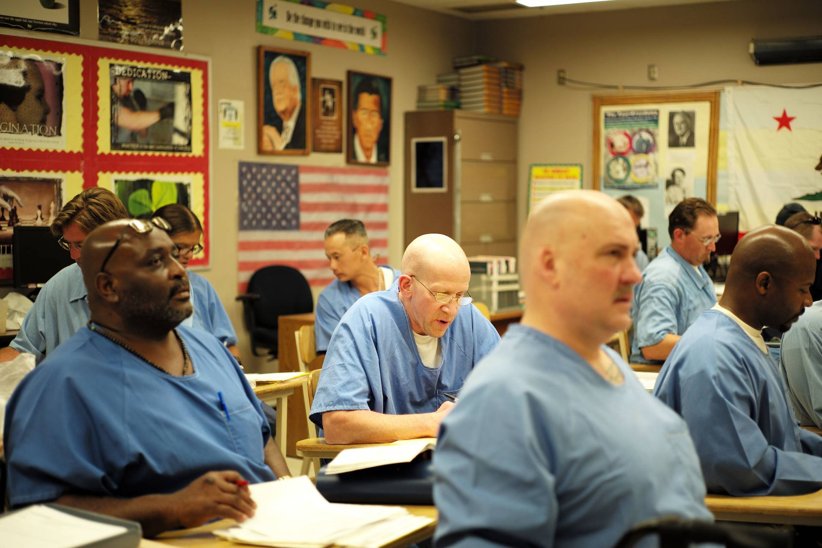
A Captive Audience

Slide 23
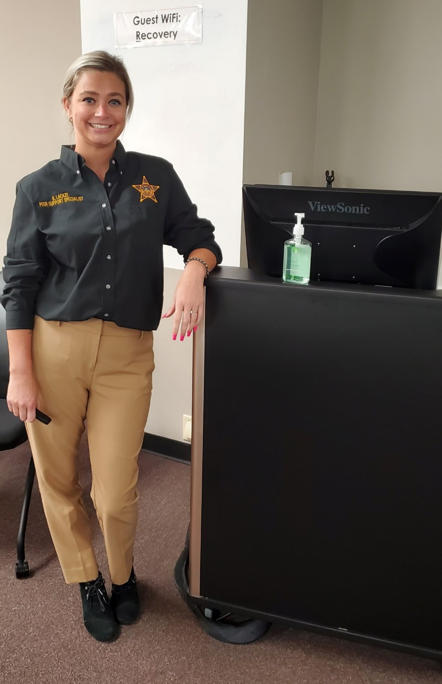
tee
GROW (Get Recovery Options Working) - an interdisciplinary outreach team consisting of law enforcement, Medication Assisted Treatment provider, Peer-and-Family Support Service provider, and a local community based organization that has established trusted relationships within the community.
Highly dependent on certified peer recovery specialists!
Notes:
What happens in an overdose: opioid receptors on the brain.
How Narcan works:
When it doesn’t work: If they have been out for too long it may not work
If they have ingested other substances (EtOH, “downers”) it may not work
They may have ingested a really potent substance

Slide 24
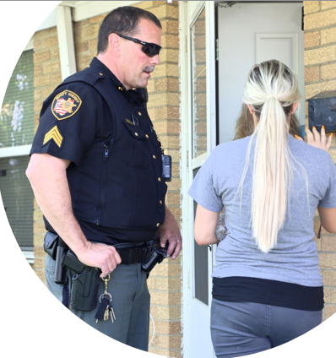
Three Approaches to GROW
Follow up with a resident who has experienced overdose in the past 48-72 hours
Peer Recovery Specialist receives overdose information; involves LE partner and treatment provider and provides education, linkage, referral and Narcan training

Slide 25
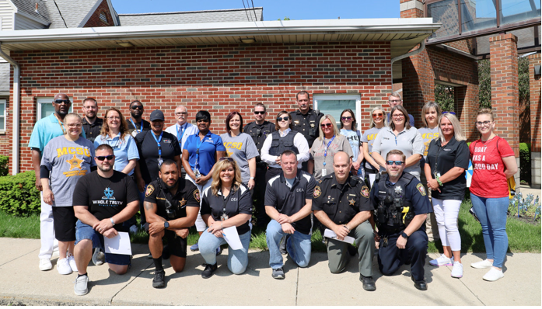
GROW Blitz

Slide 26
Moving GROW into Corrections
Peer services in jail to assist individuals throughout various stages of change

Slide 27
GROW Expanding to Include Impaired Drivers
May be released at the scene and never enter jail pretrial
Average length of time between arrest and conviction in impaired driving offenses 3-6 months
Encourages treatment during period of motivation

Slide 28
Support for Jail-Based Peer Support
An evidence-based practice
Core competencies identified by SAMHSA
Peer support:
Improves quality of life
Supports engagement and satisfaction with services/treatment
Enhances overall health
Decreases hospitalization and inpatient days
Reduces comprehensive cost of services

Slide 29
Peer support assists with:
Setting recovery goals
Inspiring hope and changes
Developing an action plan
Accessing critical resources
Solving problems related to recovery
Housing/sober living
Addressing transportation concerns
Social relationships
Improving job skills
Organizing social and recreational activities

Slide 30
Pet Therapy Services
Pet Therapy is a collaboration with the Miami Valley Pet Therapy Association
Starting in 2019

Slide 32
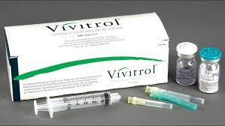
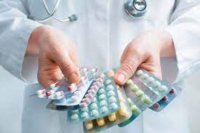
MAT
Two-thirds of people in jail meet the criteria for drug dependence or abuse.
—Bureau of Justice Statistics
Medication-Assisted Treatment (MAT)—is widely held to be a cornerstone of best practice for recovery from substance abuse. Effective treatment, including MAT, particularly when coupled with evidence-based behavioral treatment, improves medical and mental health outcomes and reduces relapses and recidivism
Notes:
Talking Points here include:
MAT, when appropriate, as a tool in the range of jail-based treatment options, the value proposition to criminal justice executives may include: • Stemming the cycle of arrest, incarceration, and release associated with substance use disorders (SUDs), as individuals with SUDs return to the community without connection to treatment. • Contributing to the maintenance of a safe and secure facility for inmates and staff . • Reducing costs: Comprehensive drug treatment programs in jails are associated with reduced system costs.5 According to the 2018 Substance Abuse and Mental Health Services Administration (SAMHSA) TIP 63: Medications for Opioid Use Disorders, “Data indicate that medications for OUD are cost effective and cost beneficial.”

Slide 33
The Cost of Impaired Driving
14,219 fatalities resulting from alcohol-related crashes
497,000 non-fatal injuries
$68.9b in economic costs
Crashes involving drivers with a BAC of .08 or higher accounted for 84% of the total economic cost of all alcohol-related crashes
Notes:
These are 2019 numbers

Slide 34
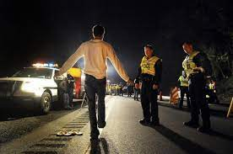
Impaired Drivers
Mandatory jail sentence for all offenses

Slide 35
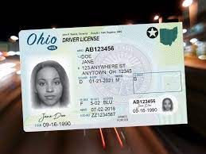
What does not work with impaired drivers?
Fines and jail alone
Traditional/basic probation
Community service
License suspension
Victim impact panels
Notes:
Traditional OVI sanctions, such as fines and jail have been found to be some of the least effective.
A study of 46 states found that post-conviction license suspension had no discernible effects on alcohol-related fatal crashes.

Slide 36
Treatment Readiness and Relapse Prevention Program
Participants learn:
Change is an active, not a passive, process
They are responsible for their behavior
They are responsible for their recovery
Treatment can help with their recovery if they are willing to do the work

Slide 37
What’s next?
Notes:
SBIRT – the screening is universal
DISCUSS JAIL DISCHARGE PLANNING HERE

Slide 39
Contact Information
Dr. Kara Marciani kmarciani@eastway.org
Teresa Russell russellt@mcohiosheriff.org
Judge Kate Huffman ohiojolhuffman@gmail.com

